Slide 1

SYNERGY/ Dartmouth Health Office of Research Operations (ORO)
Virtual Basics Training
Dartmouth Health, Research Informatics
Abel Alemayehu

Slide 2
Current DH Database Infrastructure
DH REDCap
Advarra
EDC
Feature | DH REDCap | Advarra EDC
Where hosted | DH AI (inside firewall) | Advarra
Support | SYNERGY/ Robyn Mosher | Support Analyst/ Allison Eagen
Allows PHI | Yes | Yes
Validated (21 CFR Part 11 compliant) | No | Yes
Cost to project | None | None
Cost to ORO | No license fee / support staff | $107K/year license / support staff
Study team builds the project | Yes (some guidance) | No (strong guidance)
Supports multi-center studies | Yes | No

Slide 3




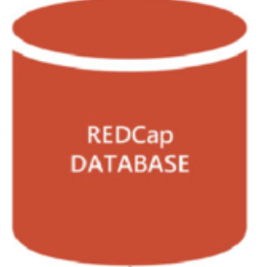

Infrastructure Transition
Training Program: Data structure, engineering and management; Database development and implementation
  21 CFR part 11 compliant Vanderbilt-hosted system
  Multi-entered investigator-initiated studies (all designs)
  First DH study active
  Investigator-initiated studies (all designs)
  Developing updated REDCap training program
  21 CFR part 11 compliant locally hosted system
  Single-site DH investigator-initiated studies (all designs)

Slide 4
Updated DH Database Infrastructure
DH REDCap
DH Research REDCap
REDCap Central (Vanderbilt)
REDCap Cloud (nPhase, Inc.)
Feature | DH REDCap | DH Research REDCap | REDCap Central (Vanderbilt) | REDCap Cloud
Where hosted | DH AI (inside firewall) | DH IS (inside firewall) | Vanderbilt (Azure cloud) | AWS
Support | SYNERGY/ Robyn Mosher | DH IS/ Abel Alemayehu | Vanderbilt/ Abel Alemayehu | nPhase, Inc. / Abel Alemayehu
Allows PHI | Yes | Yes | Yes | Yes
Validated (21 CFR Part 11 compliant) | No | No | Yes | Yes
Cost to project | None | None | $14,400/year | $8,800/year
Cost to ORO | No license fee / support staff | No license fee / support staff | No software cost/ support staff | No software cost/ support staff
Study team builds the project | Yes (some guidance) | Yes (strong guidance) | No (strong guidance) > Local build is option | Yes (strong guidance)
Supports multi-center studies | Yes | Yes | Yes (no single-site studies) | Yes

Slide 5
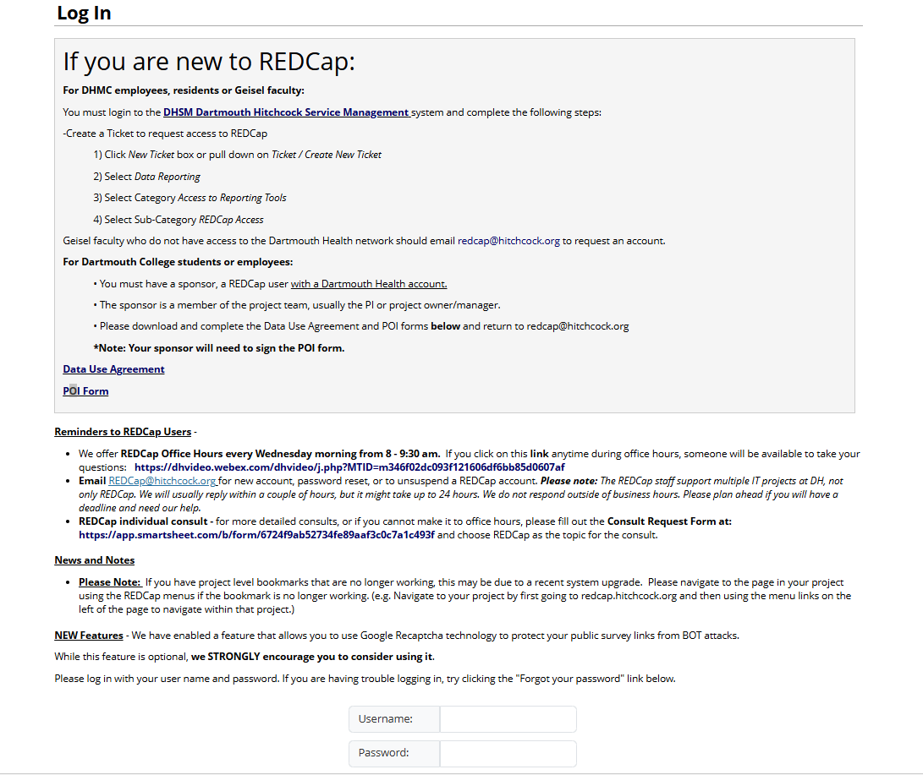
REDCap Log In Page

Slide 6
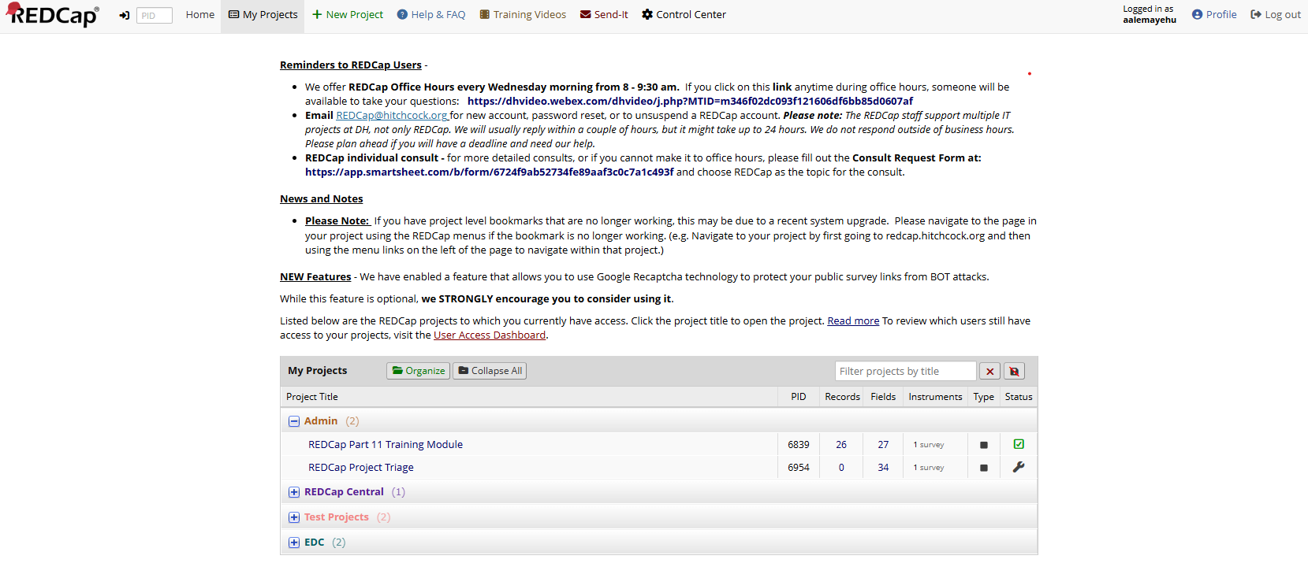
REDCap My Projects Page

Slide 7



Project Life-Cycle
Designing and developing your forms
Real-time implementation of changes
Live Data Collection
Changes in Draft Mode
When you are done with data collection and have a backup of your data

Slide 8
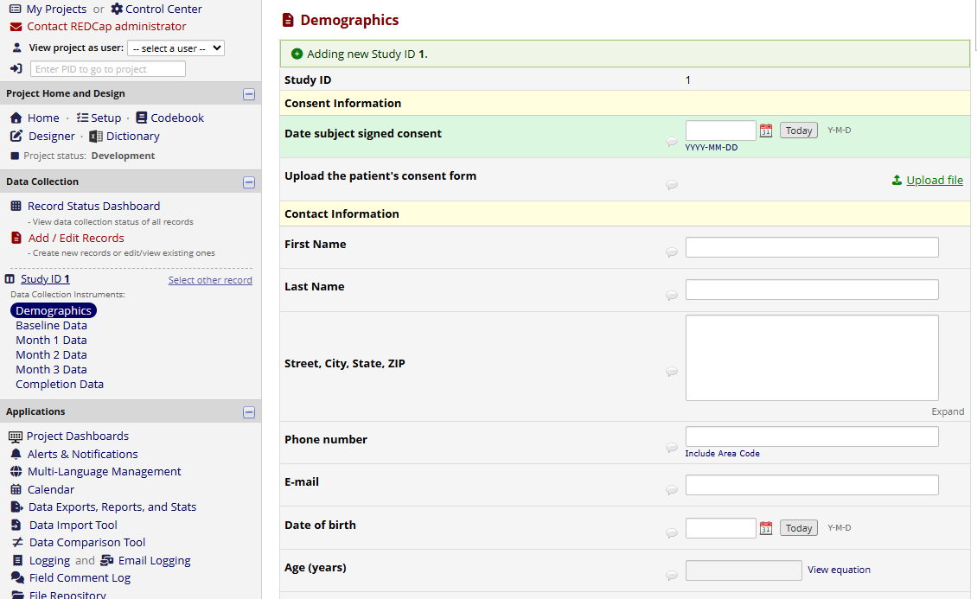
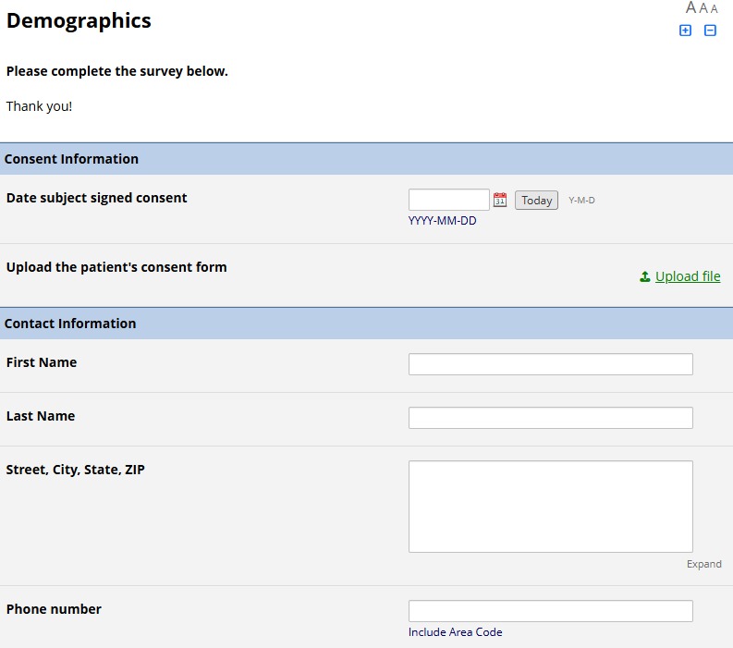
Data Collection Methods
Data Entry
Data entry personnel needs to have a REDCap account
Can enter many records on behalf of a research participant
Surveys
Survey respondents can take a survey without logging in
Distribute the survey either via the public link or email features
One-time access to survey link

Slide 9
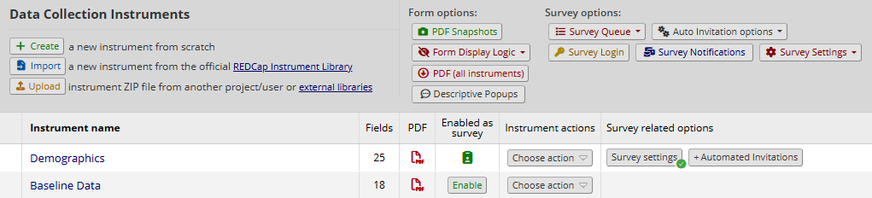
Data Collection Instruments
Data collection instrument can be
  Multiple pages of the same data collection tool, project, or survey
Rename, Copy, Delete, Download data collection instruments
Enable data collection instrument as a survey and access survey specific settings

Slide 10
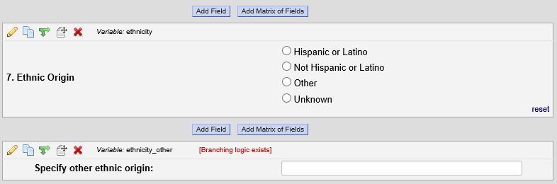
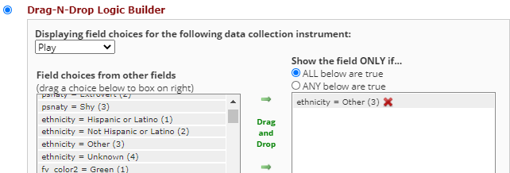
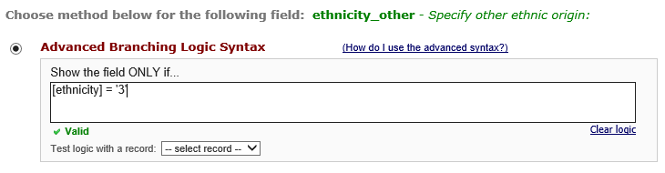
Branching Logic
Option 1
Option 2

Slide 11
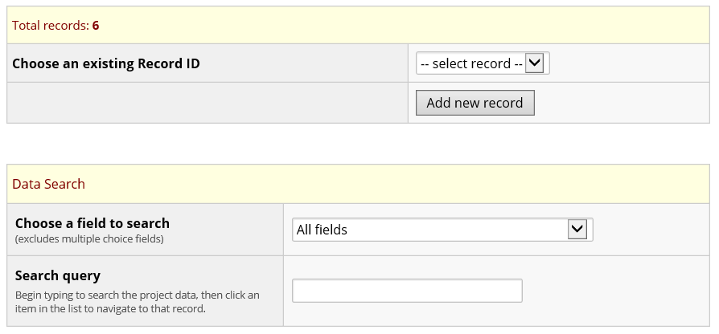
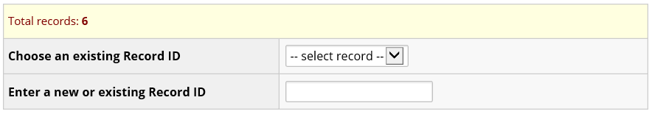
Add/Edit Records
Select an existing record from the dropdown list or the look-ahead text box
Use the data search to find existing records based on fields other than the unique Record ID

Slide 12
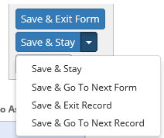

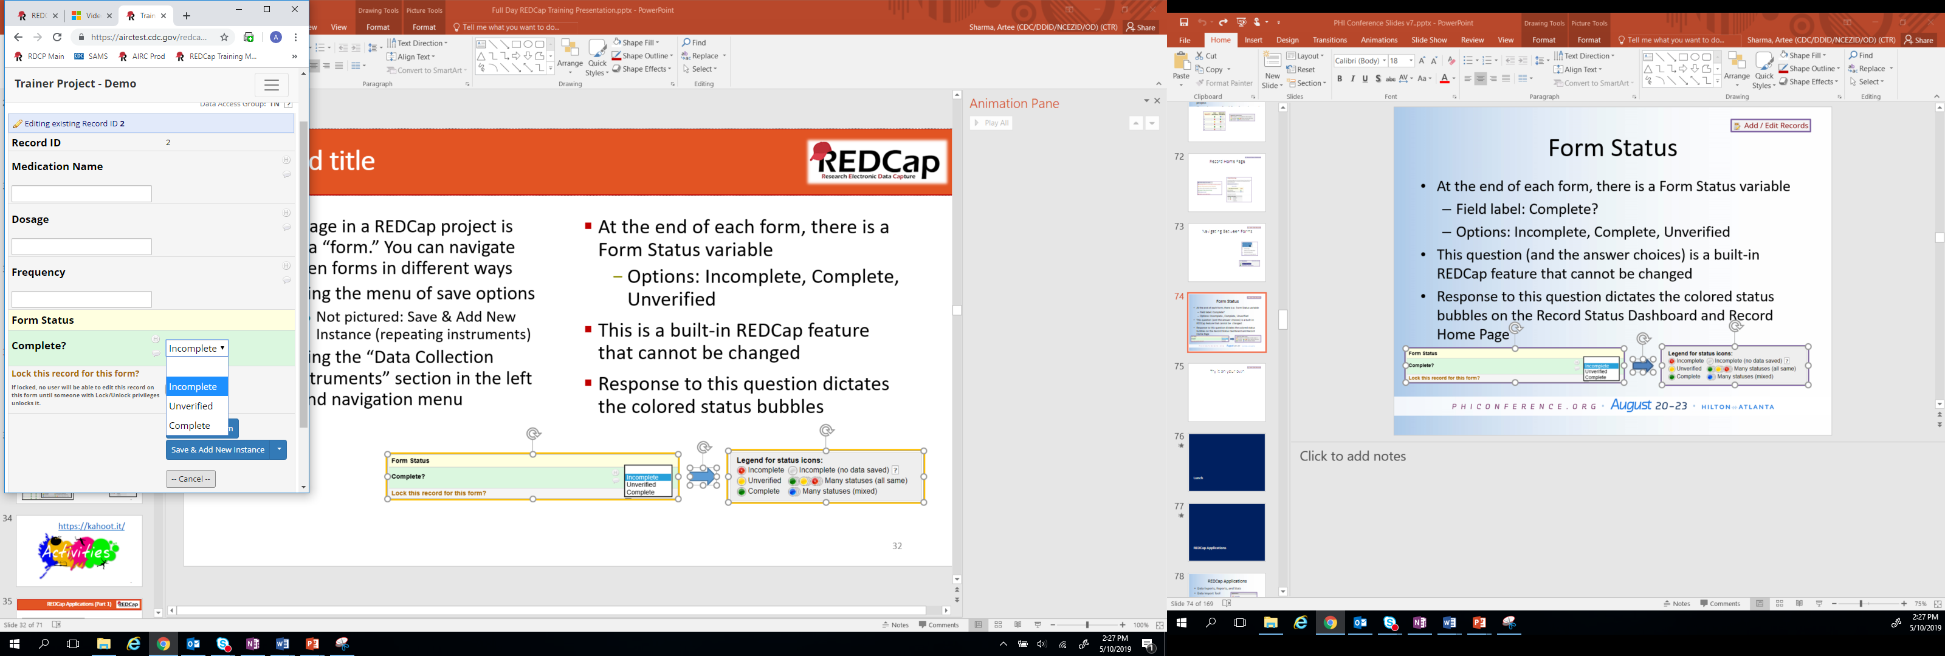
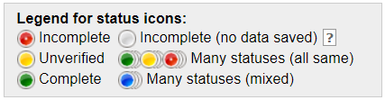
Data Entry Notes
Each page in a REDCap project is called a “form.”
You can navigate between forms in different ways
  Using the menu of save options
  Using the “Data Collection Instruments” section in the left-hand navigation menu
At the end of each form, there is a Form Status variable
  Options: Incomplete, Complete, Unverified
This is a built-in REDCap feature that cannot be changed
Response to this question dictates the colored status bubbles

Slide 13
Survey Distribution
Public Link
Unique Link
Static URL that can be posted on a website
Cannot limit the number of times one takes the survey
Used for Anonymous Surveys
Specific to an email address or record id
Can be distributed using various email functionalities
Can be anonymous
A link that does not require the respondent to login

Slide 14
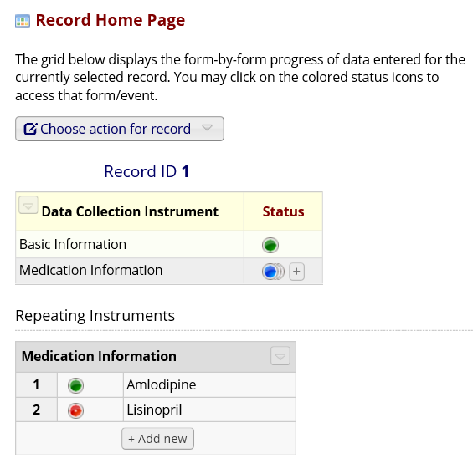
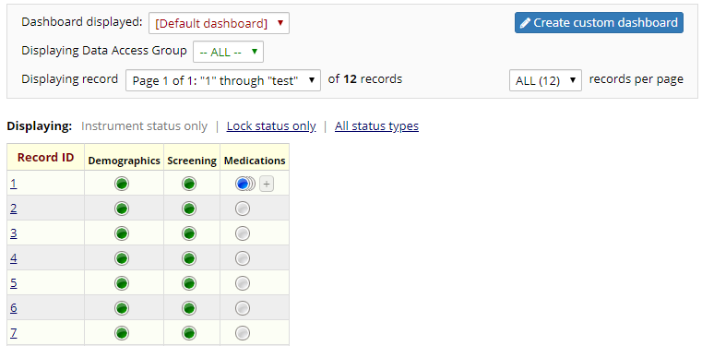
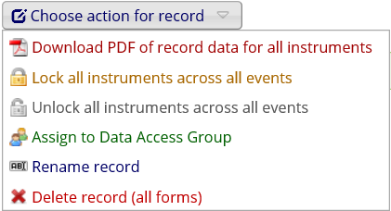
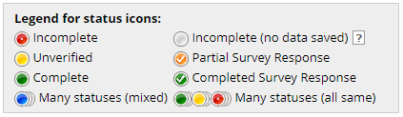
Records Management
Record Status Dashboard
Record Home Page
Provides snapshot of each record in the project
Shows the status of each form for each record
Record-level information and actions
Details on multiple instances of repeating forms

Slide 15
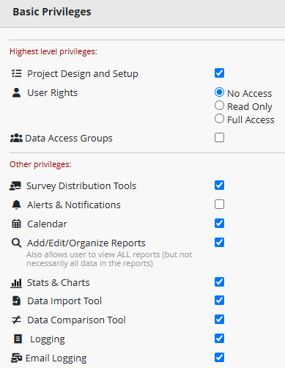
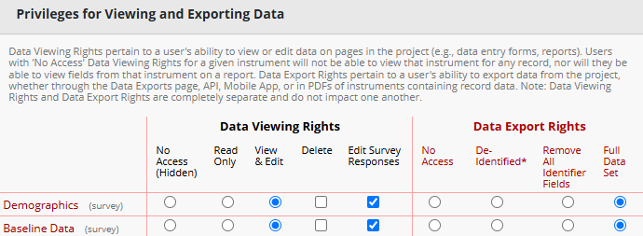
Adding Users
User Rights
Feature Level
Form Level

Slide 16

REDCap Support
Vanderbilt Training Modules
REDCap Individual Consult
DHSM Dartmouth Hitchcock Service Management
REDCap@hitchcock.org
REDCap Office Hours every Wednesday morning from 8 - 9:30 am

Slide 17


