Slide 1
myDH Research Recruitment Workflow Walkthrough

Slide 2
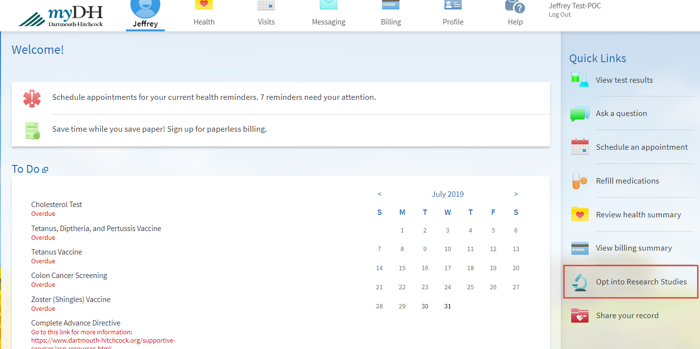
Patient View
We are planning to add a section to the myDH homepage called “Opt into Research Studies”
Notes:
We are planning to add a section to the myDH homepage called “Opt into Research Studies” on the right hand side for a “soft launch”. This can be made more visible in the future.

Slide 3
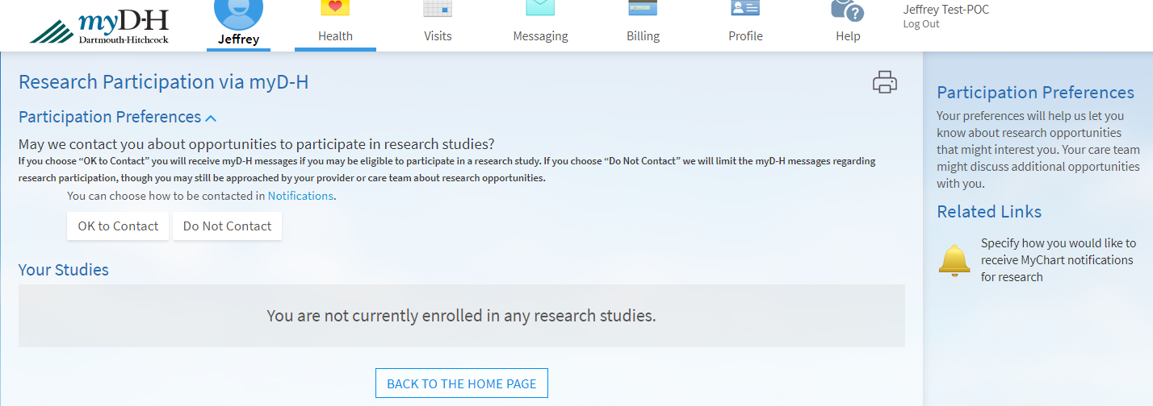
Patient View
We are able to change this language, please let us know if there are any change recommendations.
Notes:
After a patient clicks on “Opt into Research Studies” they will see this screen.

Slide 4
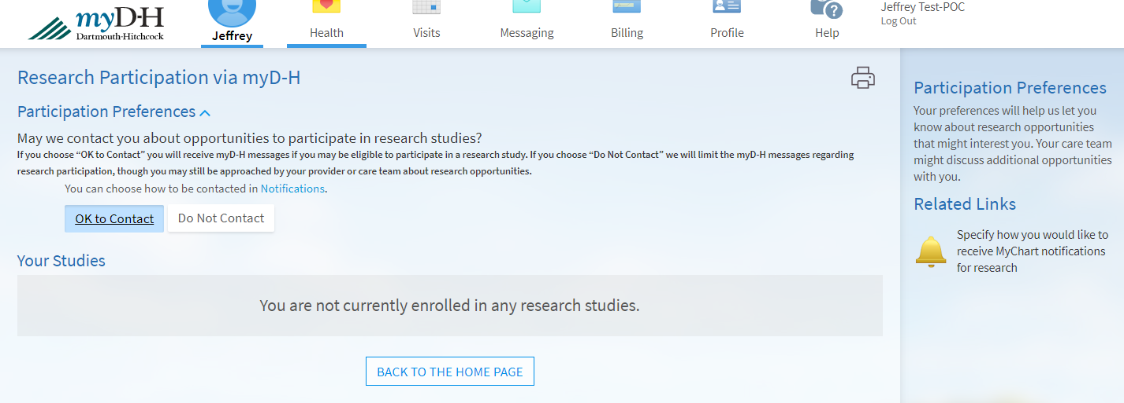
Patient View

Slide 5
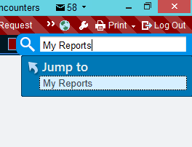
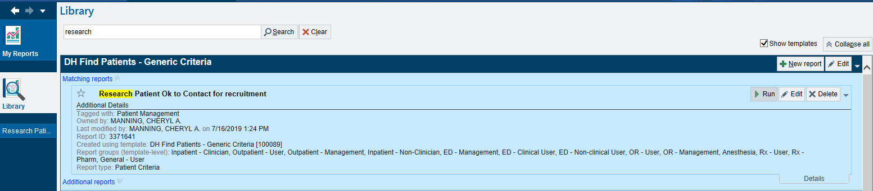
Honest Broker View
Notes:
Now, once patients have opted in, and after IRB approval, a researcher could request that a message be sent to those who agreed to be contacted AND met inclusion criteria. For example – send a message to all patients who agreed to be contacted, were over 65 AND had hypertension on their problem list. If the plan was reviewed, an Honest Broker could run the report to identify how many patients and then send a message. The ability to send a message is limited to only those we designate as an honest broker and users will not be able to generate these messages.

Slide 6
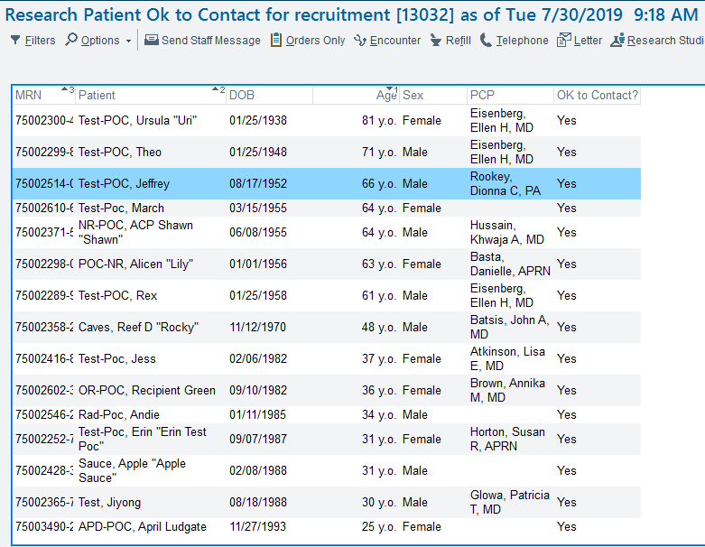
Honest Broker View
Notes:
Here is an example of a list of patients who may meet criteria.

Slide 7
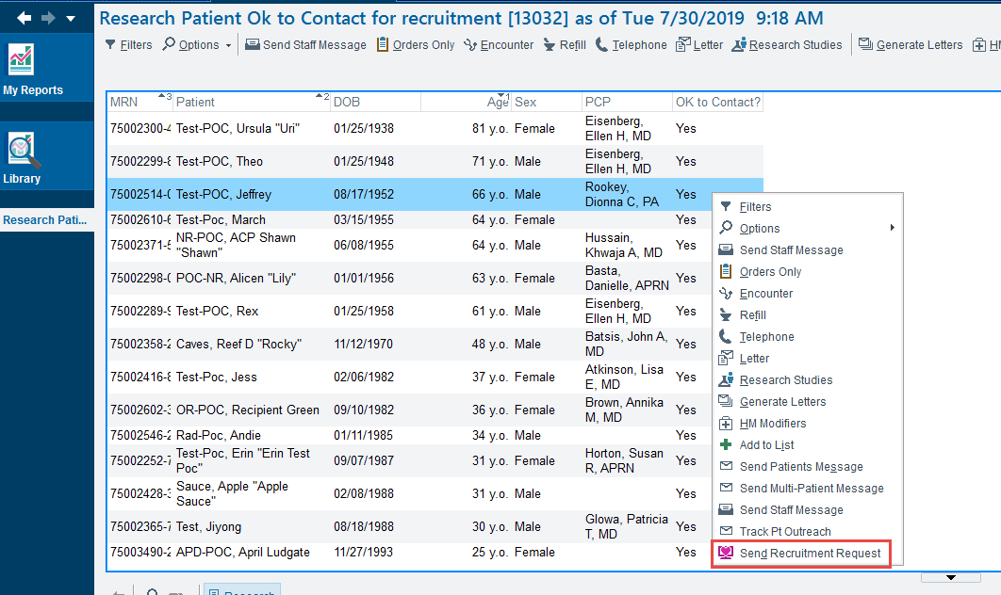
Honest Broker View
Notes:
This shows how the honest broker would send a message.

Slide 8
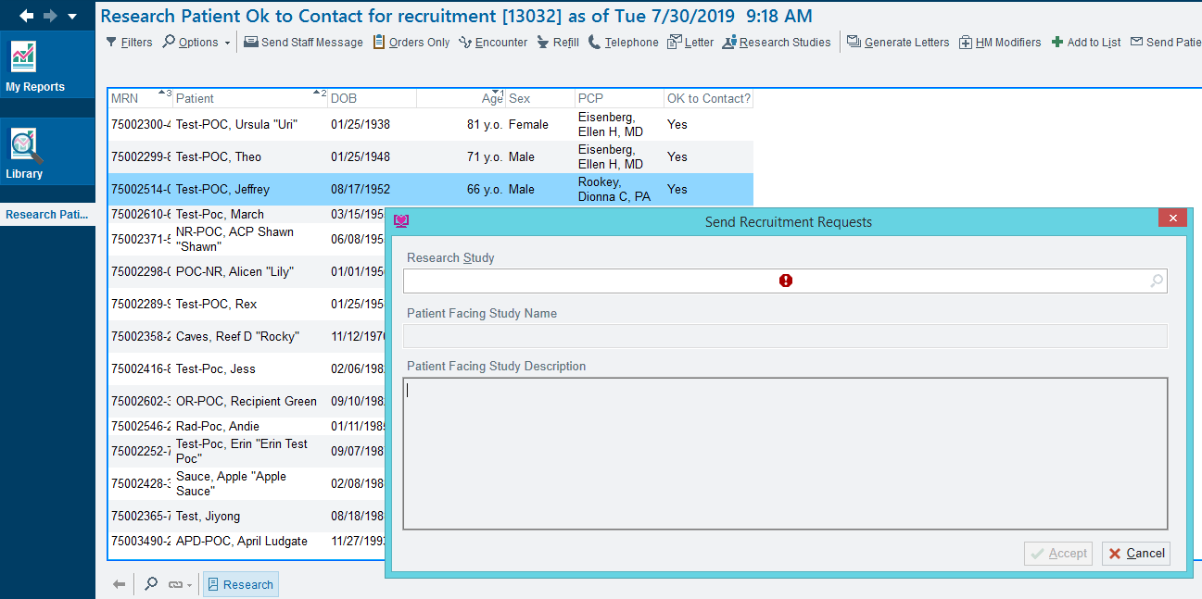
Honest Broker View
Notes:
This shows how the honest broker would send a message.

Slide 9
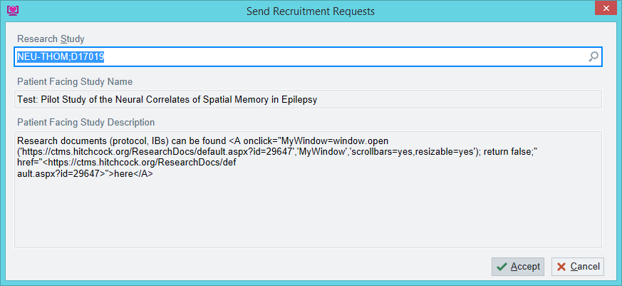
Honest Broker View
Notes:
HB can only select studies which have been set up in Velos

Slide 10
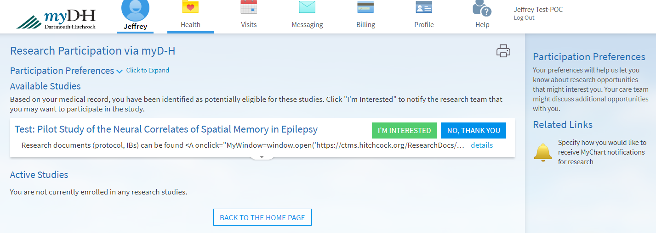
Patient View
Notes:
Here a patient can learn more about a study and if they click “I’m interested” they will see the next screen.

Slide 11
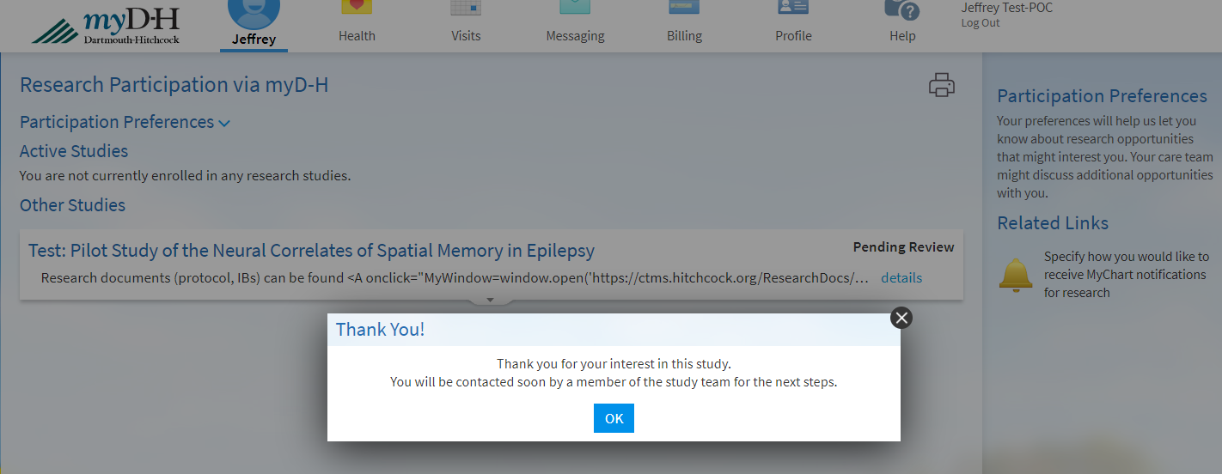
Patient View

Slide 12
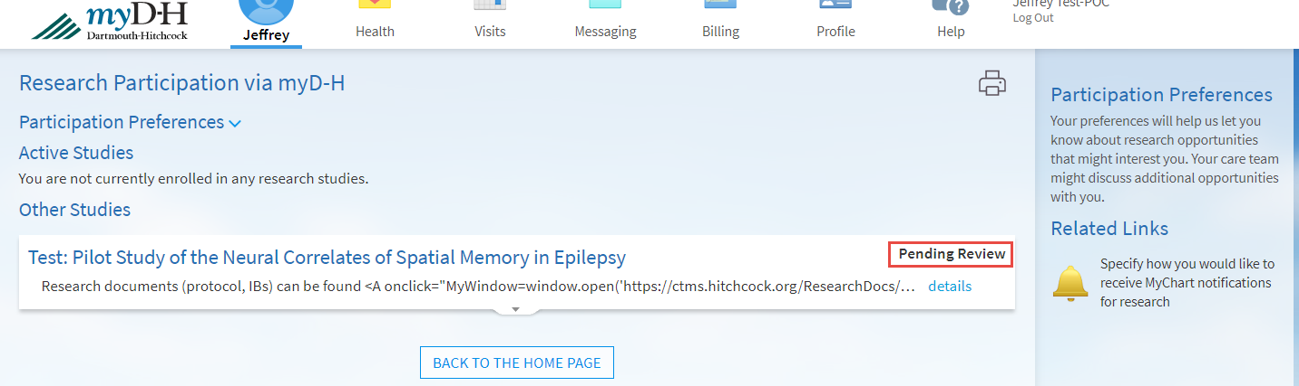
Patient View

Slide 13
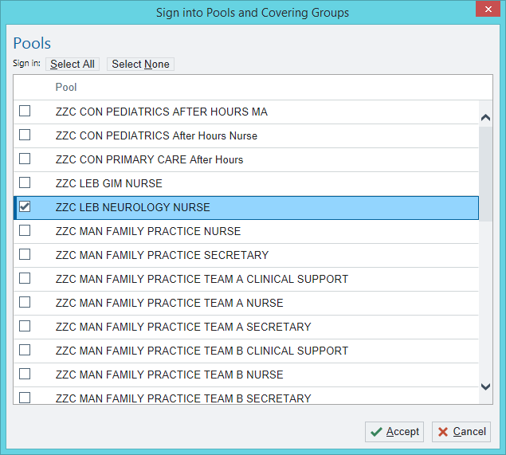
Research Team View
Notes:
Then, the study team would be set up with a “Research Inbasket” which would be monitored by the research team.

Slide 14
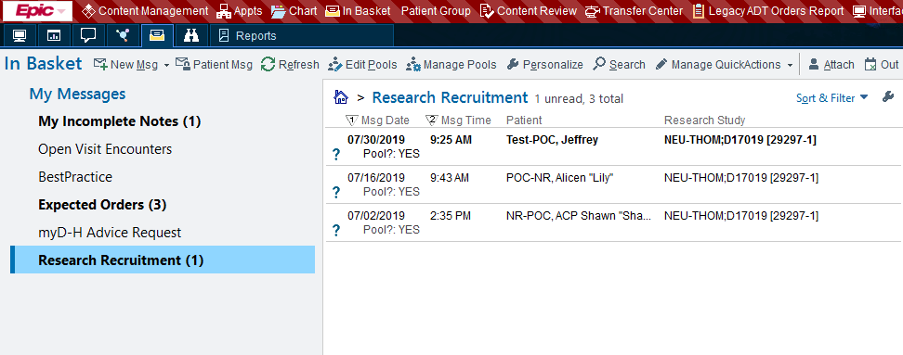
Research Team View
Notes:
If a patient said that they were interested, a message is sent to the pool and reviewed in the inbasket.

Slide 15
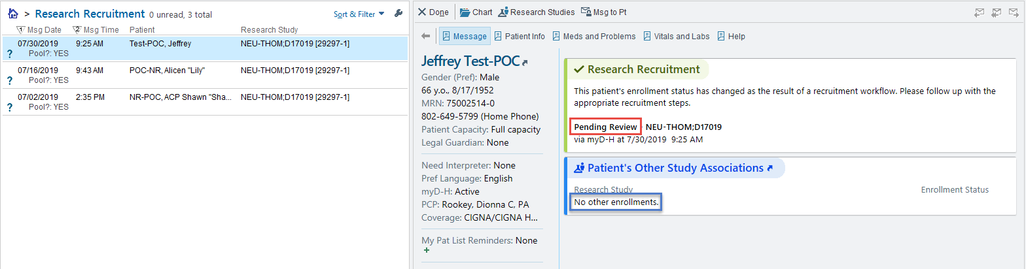
Research Team View
Notes:
At this point, the research team could review their record to apply additional inclusion/exclusion criteria

Slide 16
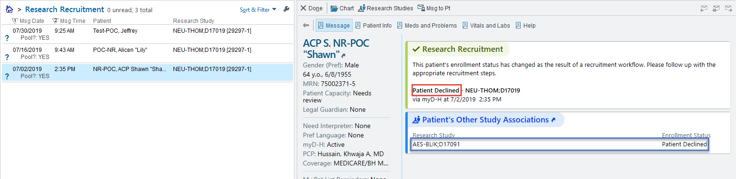
Research Team View
Notes:
Here is where they can see that a patient declined the invitation.

Slide 17
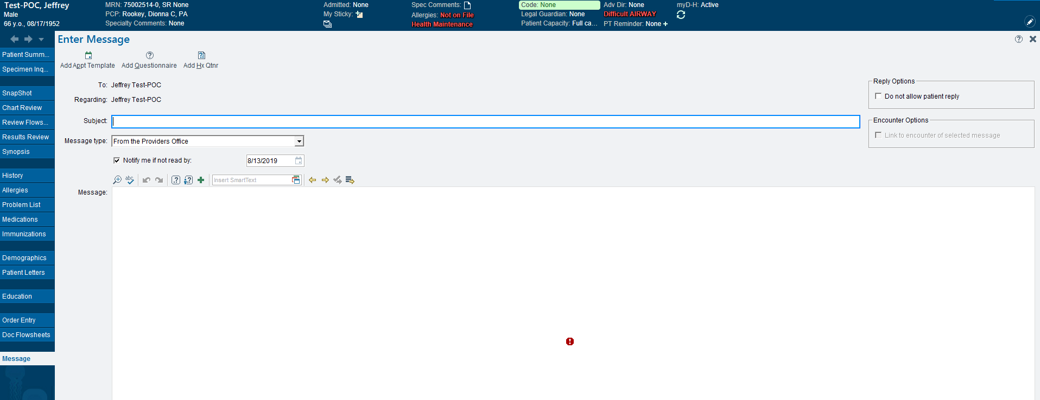
Research Team View
Notes:
If a patient has agreed to be contacted, here is where the research team could send them a message about scheduling a screening visit.

