Slide 1

OnCore Basics
Q&A
Presenter: Jessica Kiernan– DH OnCore Support
Notes:
OnCore Basics and Q&A

Slide 2
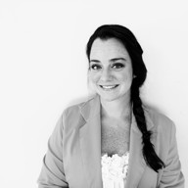
Presenter Introduction
Jessica Kiernan, BA
Advarra Staff Augmentation Resource II 2020-Present
University of Hawaii Cancer Center OnCore Coordinator 2019-2020
University of Virgina, OnCore Trainer and Support Analyst 2017-2019
St Jude Medical, Cardiac Rhythm Management, June 2006-2015
oncoresupport@hitchcock.org
Jessica.L.Kiernan@hitchcock.org
OnCore Office Hours – Tuesday at 11am via Webex (link on OnCore Resources intranet page)
Notes:
Presenter is Jessica Kiernan. Professional background includes:
9 years in medical devices, EP specialist
9 years as OnCore SME

Slide 3
OnCore Basics
Protocol Management
Calendars & Financials Management
Subject Management
Notes:
For this session, we are going to approach “OnCore Basics” with reminders on the most common workflows in the system. We will be looking at Protocol Management, Calendars/Financials Management, and Subject Management tips, focusing on the most common support questions for those areas.

Slide 4
Tracking Receipts
Paying Vendors
Sponsor invoicing
Receiving Vendor Invoices
Subject Visit Tracking
SAEs
Deviations
Payment Milestones
Pre-Award Budgeting
Treatment Details
Follow Up Details
Charge Master
Coverage Analysis
Consent, Eligibility, Enrollment details
Calendars
Subject Demographics
Protocols
Notes:
The Building Blocks of OnCore
All study records in OnCore are referred to as the PROTOCOL. Protocols are initially created in an automated fashion through an interface with the eIRB system, and then managed, through the lifecycle of the project, by the study team.
During start-up, the study team will enter additional protocol and budgeting information into OnCore, like identifying numbers from the Sponsor, grant or contract numbers, etc,. They will track study staff assignments, participating site details, and regulatory information (including use of investigational agents, provide the CTO answers to the CTO’s study intake form (which is found in OnCore). The Protocol is the foundation for all records in OnCore.
The Clinical Trials Office, in tandem with the study team’s work, will review the protocol, all the defined procedures and events, and determine whether a study CALENDAR will be built and whether that will also include a Medicare COVERAGE ANALYSIS. Leveraging the OnCore CHARGE MASTER, which is combination of clinical procedure details from eDH and general protocol-related events (like IRB fees and Administrative fees), a full study budget is built, inclusive of any sponsor defined payment milestones (like compensation for screen failures, or lump sum payments for enrollment visits or treatment visits).
Once all of the protocol details, calendar and financial details are in place, the study is Opened for accrual, and participant details can be entered into OnCore. Then on the participant level, those protocol calendar events are scheduled, tracked in OnCore, and those financial details tied to those events are processed to invoice the sponsor and vendors.
And this is the framework we work within.

Slide 5
Reminders on Protocol Management
Notes:
The following section of slides will describe just a few of the important reminders about protocol detail management that regularly get missed:
Protocol Statuses (and who can access them)
Management Groups (why do they matter)
Protocol Staff (who should be listed on a record)
Protocol Notifications (what alerts might my team receive, and who would receive them)

Slide 6
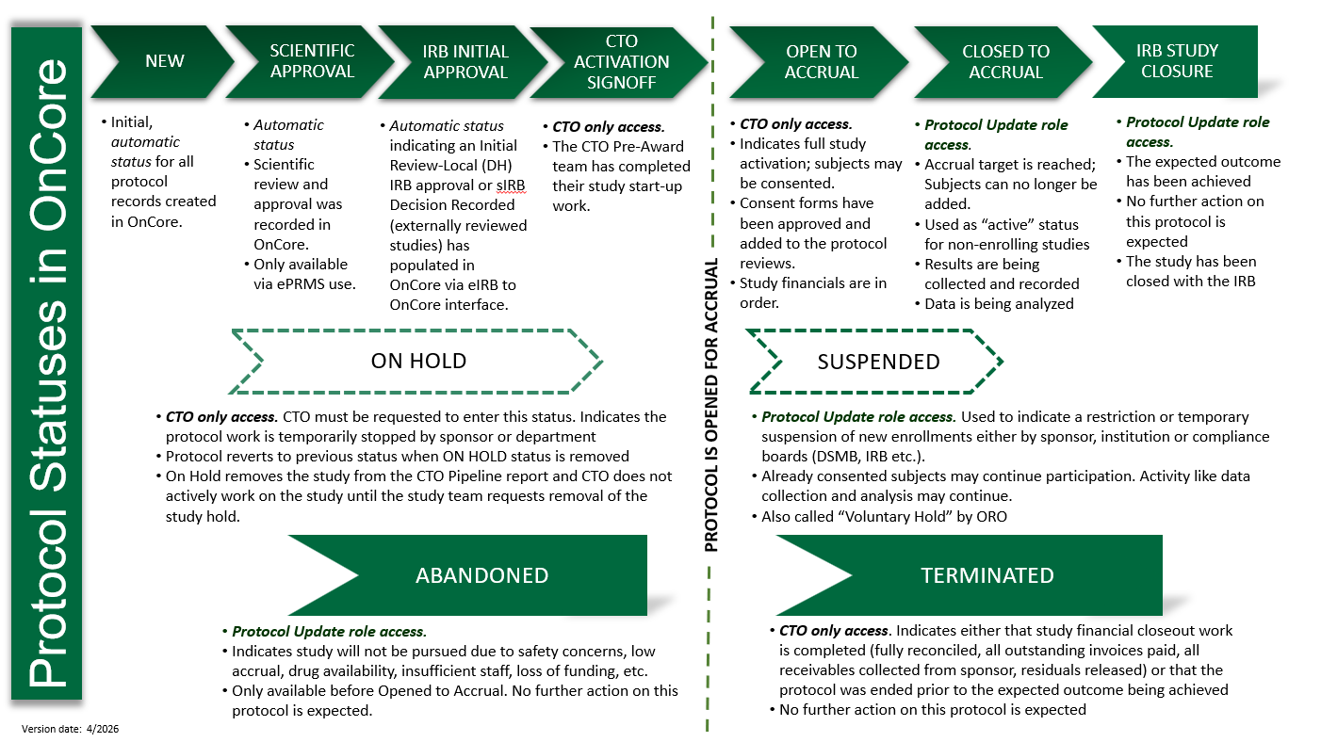
Protocol Management Reminders
Reminder 1: Protocol Status Workflow
Notes:
For our first reminder, let’s look at the whole picture lifecycle of a record in OnCore. All studies follow a linear path in OnCore and this graphic explains that path. We can’t skip steps or change these steps in OnCore.
And not everyone can affect changing a status – some are automated, some are performed only by certain teams (like CTO) and some are up to the study team to manage.
This graphic is available in the OnCore User Guide: https://one.hitchcock.org/intranet/education-research/office-of-research-operations/ctms-oncore-updates/oncore-training-manuals/data-entry-guide-SOPs

Slide 7
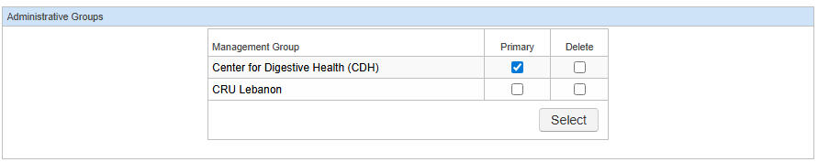
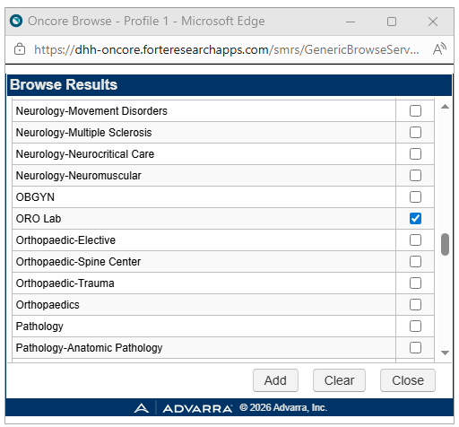
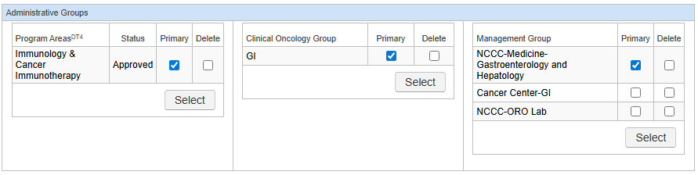
Protocol Management Reminders
Reminder 2: Primary Management Groups
Notes:
Management groups
They are a superpower in OnCore – I refer to them as study tags. In app -- They are for two main things – access and reporting. In fact, there’s a whole console in OnCore that uses Mangement groups – The Team Console. So if you are the team managing this record overall, make sure you are represented on that Mangement tab and consider that you probably should be flagged as Primary. Then, if any other teams are supporting this work, make sure they are listed too… Reports can be run showing which studies which teams are working on or have worked on in the past.
Then outside the app – they power the websites for Find a Clinical Trial which is why two things are important here – first, always indicate a primary and second, make sure that primary is the department/specialty under which this study sits.
To find this page, go to PC Console >> Main >> Management tab
Click Update
Click Select under Management Group
Check one or more management groups to add to the protocol
Mark one as Primary and click Submit
NOTE: Be sure disable the pop-up blocker or the Select window won’t appear.

Slide 8
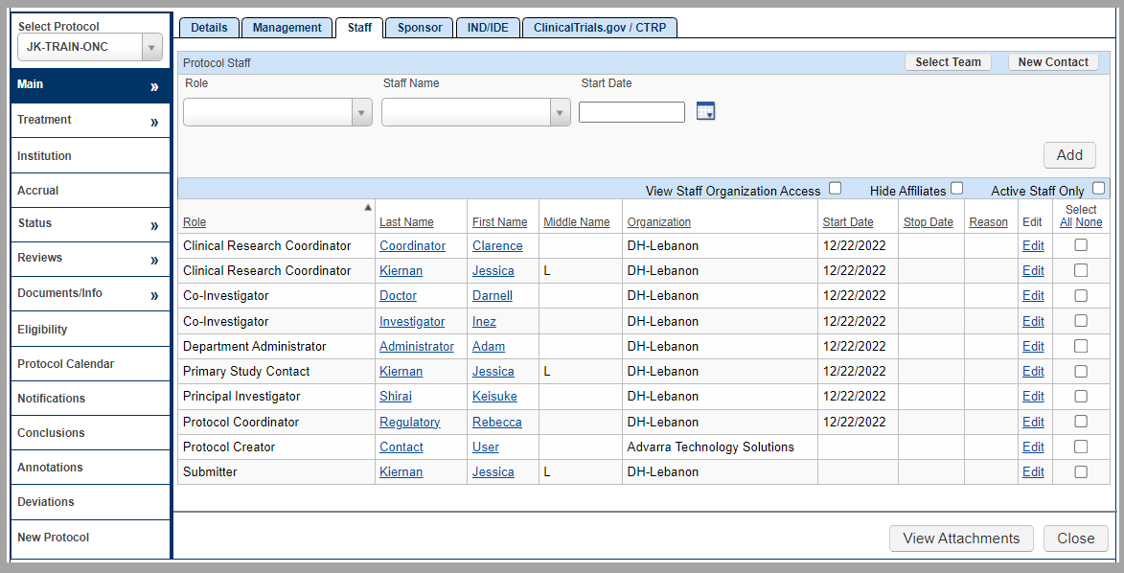
Protocol Management Reminders
Reminder 3: Protocol Staff
Notes:
PC Console >> Main >> Staff tab
Lets talk staff list
IRB personnel will appear with IRB sync. We have a job aide that describes what roles that get selected in IRB will make it OnCore and how they will be listed
Primary designations – CRC-Primary, Protocol Coordinator-Primary should be indicated when you have multiple personnel listed in the same role… and a Primary Study Contact should be listed manually on all studes (key functionality tied to notifications and OnCore Support needs!)
3) Add Department Administrator (key functionality tied to notifications)
Next, pay attention to the Start and Stop Dates. If someone gets listed more than once on a record, that’s fine, but they should have different start and stop dates or otherwise it looks like a duplicative entry (and we will ask for cleanup there).
And finally, play with the Active Staff checkbox. This toggle box will update your view of the staff list based on who appears to be active and who may have been involved previously.

Slide 9
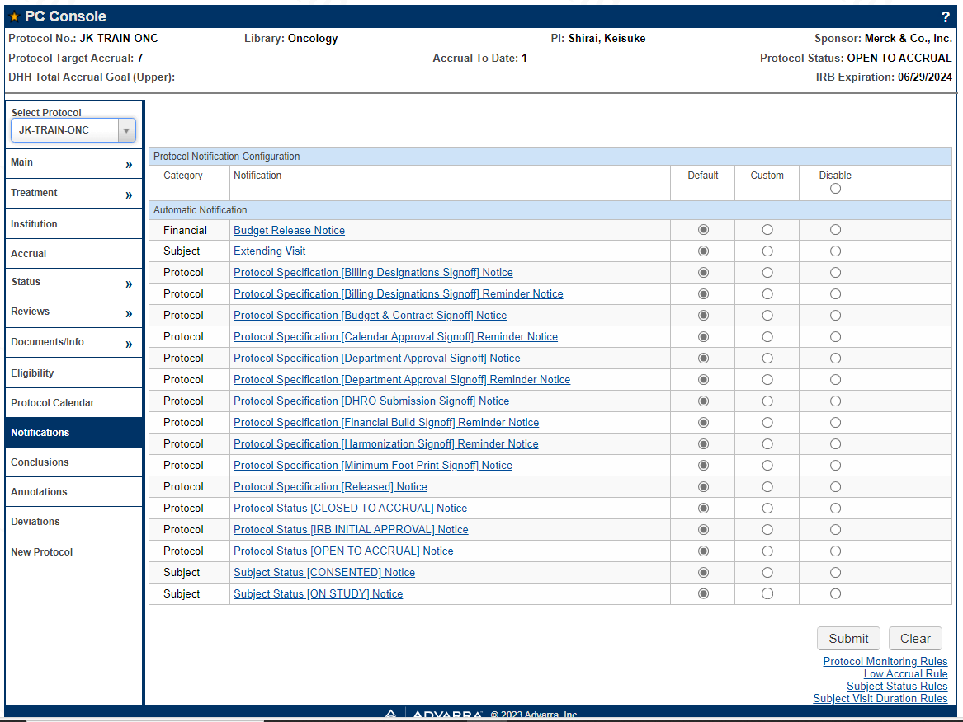
Protocol Management Reminders
Reminder 4: Protocol Notifications
Notes:
PC Console >> Main >> Notifications tab
There are a number of notices set up to automatically be delivered when actions are performed in the system. (and yes, there are also other notifications set up outside of OnCore). In OnCore…
You can view any notification on a protocol to see who specifically would receive the notice. Click the hyperlink to see how the notification is set up to work, then click the Preview button to see which email address in Oncore would receive the notice.
These are editable! Ask OnCore Support if you need access to this section.
And we have a job aide that describes the currently active global notifications

Slide 10
Reminders on Calendars & Financials Management
Notes:
Now we will look at Calendars and Financials management. Two tips on Understanding Calendar Builds and Understanding Financial Builds

Slide 11
Subject Management Reminders
Reminder 1: Calendar Builds
4 keys to learning your OnCore calendar:
  Use the job aides
    ‘Understanding Calendar Builds’ & ‘Calendar Build Worksheet’
  Go to Menu > Forms/Calendars > Specifications
    View your study calendar Treatment Visits tab
  Preview the calendar
    View your study calendar Calendar tab
  Test the calendar
    Ask OnCore Support for help
Notes:
Every calendar will functionally have the same bones – there will be banks of visits (segments) which rely on a particular subject status date be entered to reveal those projected visit dates. Some status dates being entered will act as an Off switch for those banks of visits. We will repeat this tip in the Subject management section too and talk more about how those subject statuses affect calendars.
For this reminder – here’s some steps to learn about your calendar build… but first, a poll. How many folks here actually go to their calendar build and talk about it with your team when their study gets activated?
To go our Job Aides page and download two documents – the Understanding Calendar Builds job and and the Calendar Build Worksheet. These help guides will walk you through the steps to identify how this calendar works
Go to the build itself and take a look at it. Using the help documents, see if you can answer the questions in t he worksheet about the build.
Preview the calendar
If you want to fully test the calendar, ask OnCore Support for help. We will build the same calendar in our Train environment and you can run a subject through the calendar and see if it functionally makes sense for your work.

Slide 12
Subject Management Reminders
Reminder 2: Financial Builds
3 Keys to learning your OnCore Financials:
Know your Calendar
View the Financials Console & download the budget
Reach out to Finance
Notes:
Now Financials… so, not all studies will have a budget fully built in OnCore. The CTO will determine which studies do, and there are some keys to knowing when there is a full budget built and how to figure out what to do with it.
Three keys to learning about your study financials in OnCore:
First, do the steps from the previous slide – learn your calendar build. Once you know your calendar, and know what visits to check in etc, you can expand from that detail
Then go to Financials Console and view (plus download) your BUDGET CALENDAR. Also for viewing, two tabs I suggest are the SUBJECT RELATED and PROTOCOL RELATED events tabs.
Talk to your assigned staff accountant in Finance (PC Console > Main > Staff tab). Ultimately, every budget will have some nuance, so if you’re not able to get the information you need for how the study financials will be managed from looking in OnCore yourself, ask your assigned Finance person.

Slide 13
Reminders on Subject Management
Notes:
Now we will look at Subject management and spend time on calendar functionality.
Five reminders here – Subject Status Workflow, Subject Statuses & Calendar Functionality, Visit Verification (check-in) and Unscheduled Visits

Slide 14
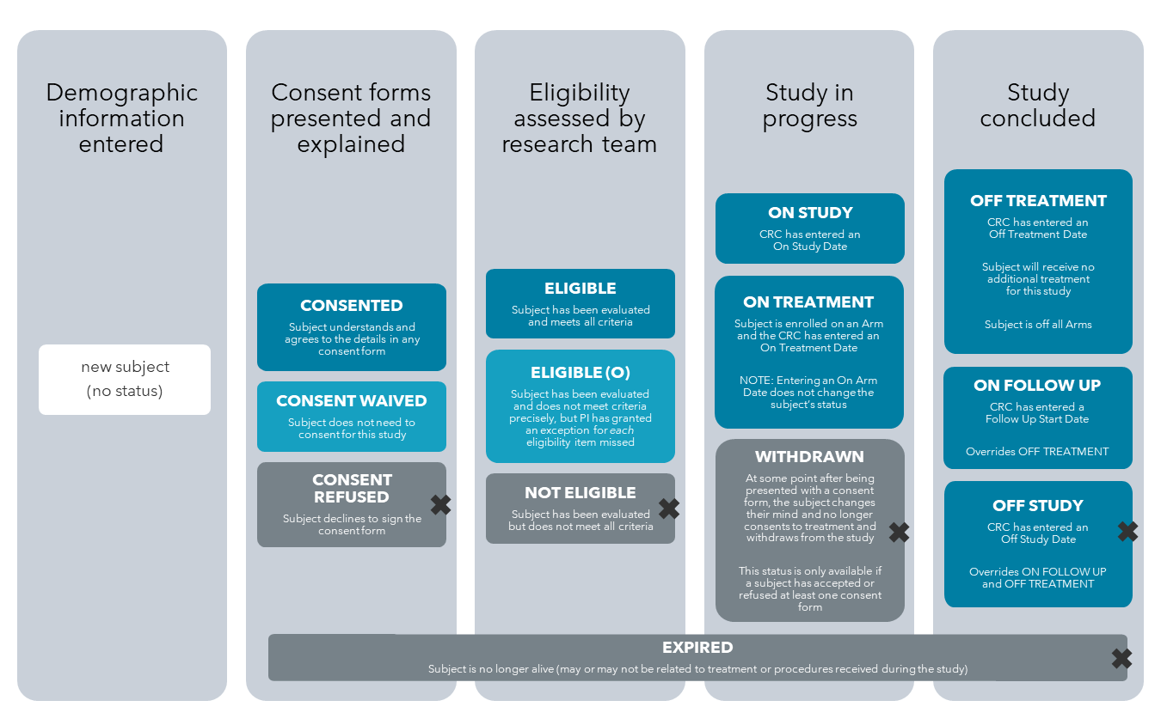
Subject Management Reminders
Reminder 1: Subject Status Workflow
Notes:
Subject Statuses, similar to OnCore Protocol Statuses are also… LINEAR.
Every subject registration record should have represented key milestone dates on that participant’s record, including consent, eligibility, enrollment details and completion details.
Subject status is very important for reporting and tracking subjects but also key for accessing subject visits on the calendar. This graphic explains what these statuses represent in OnCore.

Slide 15
Subject Management Reminders
Reminder 2: Subject Status & Calendars
Start Date (aka Anchor or Trigger date; from Calendar Build) | Subject Status that Activates Visit | Subject Status that Locks Visit
Treatment
Consent Signed | Consented | Off Study
On Study | On Study | Off Study
On Arm | On Arm | Off Arm; Off Treatment; Off Study
On Treatment | On Treatment | Off Arm; Off Treatment; Off Study; On Follow Up
Off Arm | Off Arm | Off Arm; Off Treatment
Off Treatment | Off Treatment
Off Study | Off Study
End of Previous | Follows the status that immediately preceded it
Follow Up
On Study | On Study | Off Study; *Date of Progression
On Follow Up | On Follow Up | Off Study; *Date of Progression
*Date of Progression | *Date of Progression | Off Study
Notes:
Every calendar will functionally have the same bones – there will be banks of visits (segments) which rely on a particular subject status date be entered to reveal those projected visit dates. Some status dates being entered will act as an Off switch for those banks of visits.
Use this guide to help remind you that segments of calendar visits are configured to become active once a particular status date is entered or Arm information is updated for the subject.
Also, progressing past these statuses will affect ability to access visits – see the Subject Status that Locks Visits to understand that relationship (ie. If a segment has a start date of Consented, and is then placed Off Study, the visits associated with the Consented status are no longer available)
And then, go look at your calendar build and see if this chart helps make sense of what workflow is expected.

Slide 16
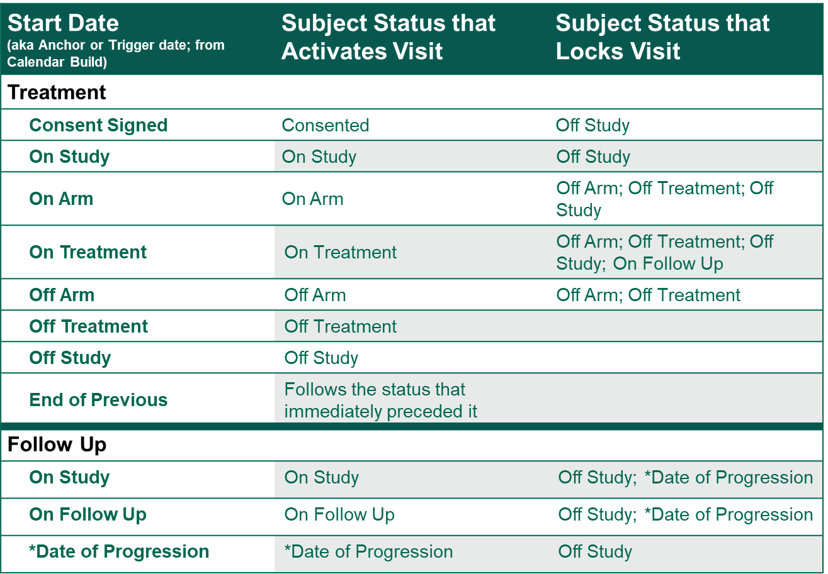
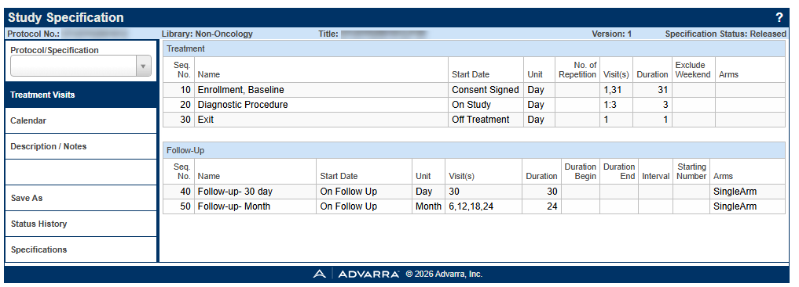
Reminder 2 cont.: Subject Status & Calendars
Subject Management Reminders
Notes:
To find that calendar build info, go to Menu > Forms/Calendars > Specifications > Treatment Visits tab.
See the Start Date column and this will tell you which dates are needed to be entered for particular banks of visits to show. Then, be sure to revisit that previous chart so you can know when a particular bank of visits also may not be available any longer.
Favorite that Specifications Console!

Slide 17
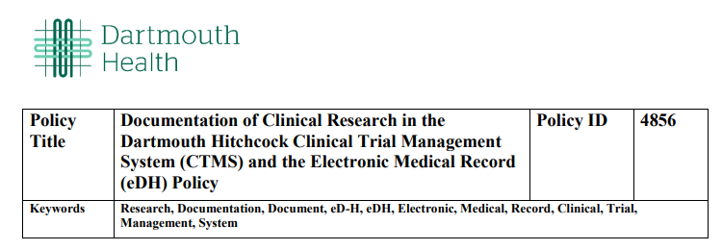
Subject Management Reminders
Reminder 3: Rules on Subject Visit Tracking
You have 3 business days to complete documentation in OnCore, including:
  Subject Registration
  Subject Consent
  Visits completed
  Procedures performed
Notes:
Reminder 3 – there are rules. Specifically around timing of data entry, so be sure to review this policy and do your best to get the data entered within 3 business days of an event occurring.
NOTE: if registration or consent is not completed within 3 business days of consenting the study subject, notification must be sent to CTOFinance@Hitchcock.org to avoid the subject being billed.
Ultimately, try to get the details recorded in OnCore as soon as possible. Consent directly affects the eDH bill hold (because it is the Research Flag trigger date).

Slide 18
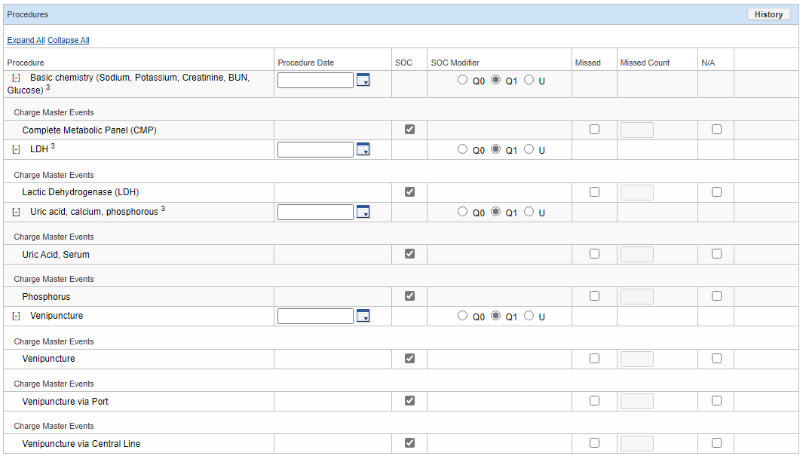

Subject Management Reminders
Reminder 4: Verifying Subject Visits
Notes:
Verifying subject visits and understanding what you’re seeing in the visit procedures section:
Record this visit as occurring within 3 business days of it happening – this is not only a best practice but a DH policy
Review list of procedures – have they all been conducted, any missed, any additional?
*Important: accurate and timely entering of subject visit information is the goal. This drives financials & reporting compliance****
3) Be mindful of the SOC columns... If they have a check, that means they were programmed into the schedule of events as normally to be billed to insurance. If that needs to be changed, uncheck the box and enter a comment about the reason for the change. Finance will review these details.

Slide 19
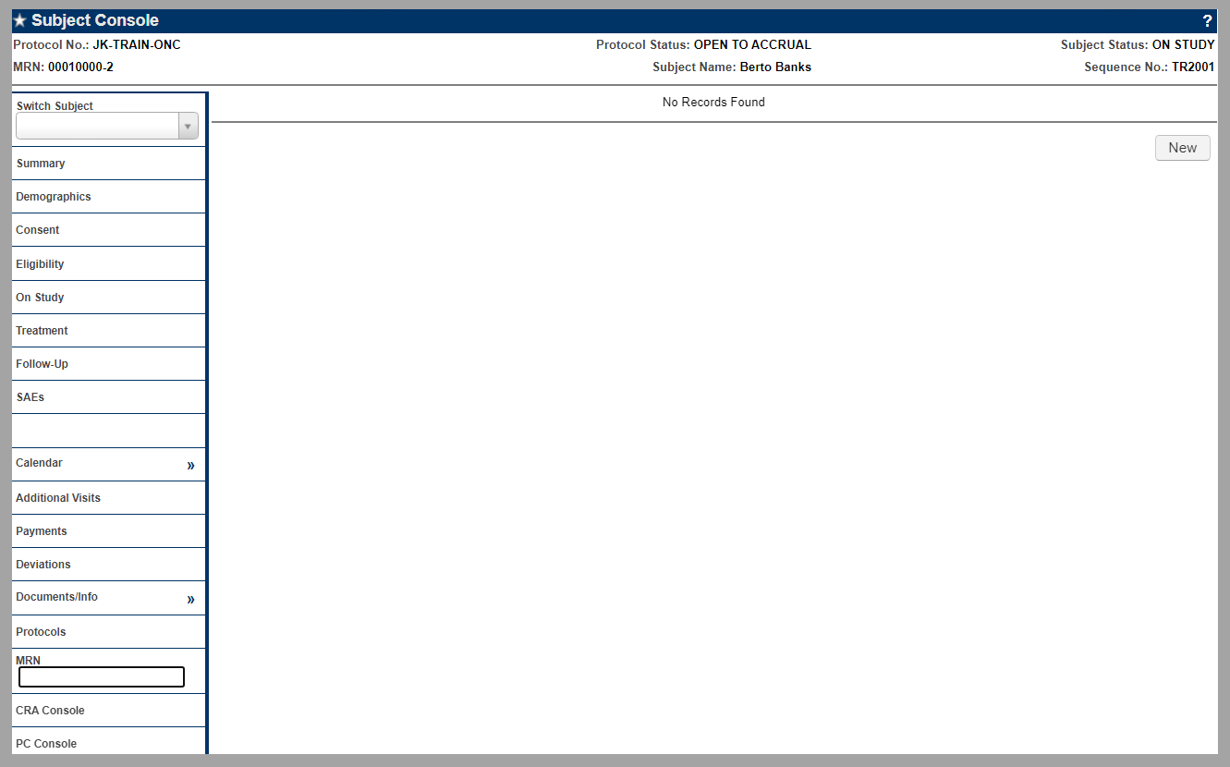
Subject Management Reminders
Reminder 5: Unscheduled Visits
Notes:
Scheduled Visits = those visits built into the studies schedule of events, are found on the Calendar tab.
If a subject comes in for an unscheduled visit, create that by going to the Subject Console > “Additional Visits” tab and clicking “New”

Slide 20
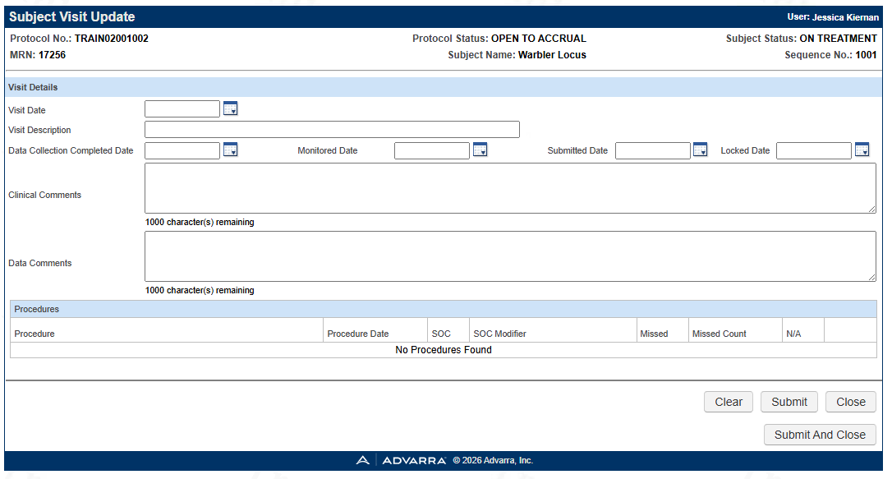

Subject Management Reminders
Reminder 5 cont: Unscheduled Visit Procedures
Notes:
The Additional Procedures button is available once the visit record has been saved. This is also the case for scheduled visits.
Use the Additional Procedures button to indicate what procedures happened at this Unscheduled Visit.

Slide 21
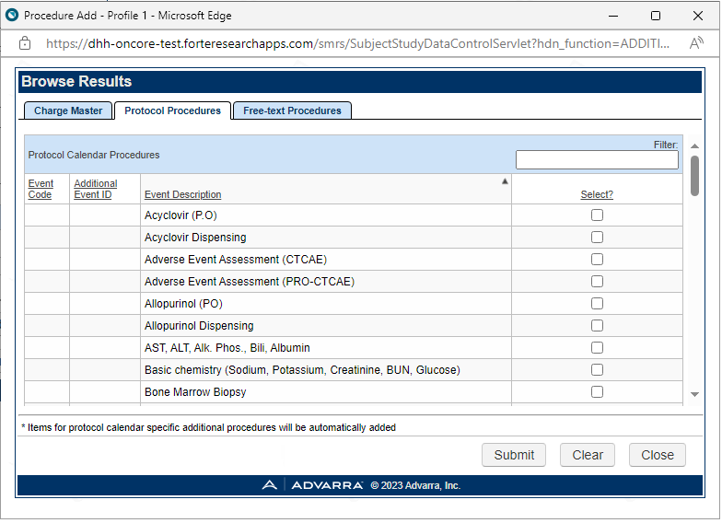
Subject Management Reminders
Reminder 5 cont.: Unscheduled Visit Procedures
Notes:
Procedures that have been added to the calendar will appear on the “Protocol Procedures” tab. Think of this as a quick pick list of those procedures expected to happen during the study. Use the Free-text (or charge master) tab to indicate procedures that happened that were not on the normal schedule of events.

Slide 22
Thank you!
Notes:
Thank you for your time! If you have any questions or would like additional opportunities to learn more, please reach out to OnCore Support at DH (oncoresupport@hitchcock.org)

