Slide 1
Lunch and Learn:
The Research Informatics and Data Governance (RIDGe) Process
March 24, 2026
Kristen Anton
Director, Research Informatics
SYNERGY/ Dartmouth Health Office of Research Operations (ORO)
Dartmouth Health ORO - SYNERGY
Research Informatics

Slide 2
What we will cover today:
  What is Research Informatics and Data Governance (RIDGe)?
  Why RIDGe?
  How does RIDGe fit into the study activation process?
  What projects need RIDGe review?
  What research activities do not need RIDGe review?
  How do I submit my project for RIDGe review?
  Why is the content of the Data Request Form important?
  What comes after RIDGe review?
  Use Cases
Q & A
Dartmouth Health ORO - SYNERGY
Research Informatics

Slide 3

RIDGe: Research Informatics and Data Governance Committee
  Created by Tim Burdick in 2023 in response to bottlenecks and questions about process
  Exclusively DATA and INFORMATICS FOCUSED
  Brings together expertise from across the DH research and informatics community to expedite the activation of DH investigator-initiated research projects
    Leadership of Research Informatics, HPPR/IRB, the Analytics Institute, the Clinical Trials Office, Clinical Informatics, Research Quality and Safety, and the Privacy Office
    Dartmouth College Data Science faculty
    Other subject matter experts as needed
  Ensures DH data are appropriately handled
  Formulates policy where needed
  Convenes weekly (Tuesdays at 1:00) to review research protocols
  Typically approves projects within 1 – 3 weeks
  Current backlog = 0
  “No-no” policy: the goal is to get your study approved and running!
Dartmouth Health ORO - SYNERGY
Research Informatics

Slide 4


RIDGe: Research Informatics and Data Governance Committee
GOALS:
  Efficiency
  Support
Dartmouth Health ORO - SYNERGY
Research Informatics

Slide 5
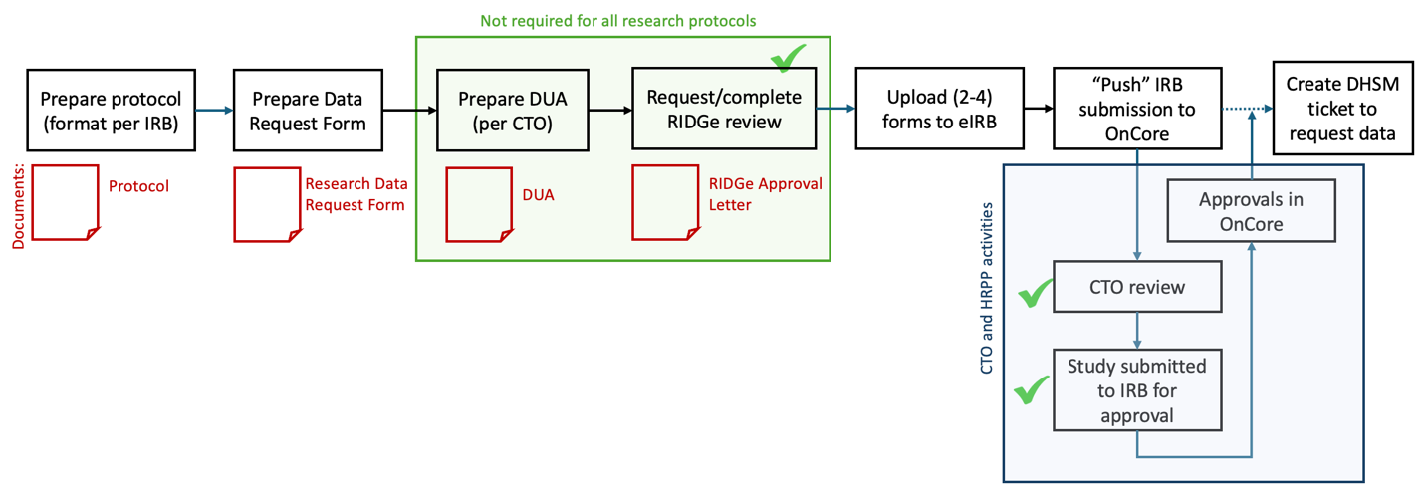
Research Study Workflow
High-level process overview:
Documents to be generated (in red)
Possible steps and corresponding documents (in shaded green box)
Activities that may be performed by ORO teams (blue shaded box)
Areas where approvals would be required (green check marks)
Dartmouth Health ORO - SYNERGY
Research Informatics

Slide 6
What studies require RIDGe review?
RIDGe will review a research study if the protocol is proposing:
Manual chart review for data abstraction
Accessing PHI (e.g., from eDH and other electronic health record sources) for preparatory to research activities, where preparatory to research activity is defined as the use or disclosure of PHI (without removal of the PHI from the DH Covered Entity) for the purpose of determining the scope, feasibility, and/or potential participants for a future research study
Use of clinically sensitive data, business confidential data, or social security numbers
Use of third-party software, websites, or information technology not approved for use by DH Information Systems (IS) Security
Storage of research data on systems or platforms that have not been approved by DH IS Security
A protocol modification that proposes any of the above activities
Other teams reviewing a protocol, e.g., IRB, Analytics Institute, or CTO, may request that RIDGe review a study.
Dartmouth Health ORO - SYNERGY
Research Informatics

Slide 7
What studies do not require RIDGe review?
There are data-focused activities and studies that do not require RIDGe review:
Projects that are not considered research
  Studies that do not meet the regulatory definition of ‘Research,’ including Quality Improvement (QI) activities
  Studies that do not meet the regulatory definition of “Research with Human Subjects,” as determined by the IRB
Projects with close oversight by the Clinical Trials Office (CTO)
  Sponsor Initiated Trials, including Cooperative Group trials
  Expanded Access (also called Compassionate Use) trials
Please request a consult if you are unsure whether the research study requires RIDGe review!
Dartmouth Health ORO - SYNERGY
Research Informatics

Slide 8

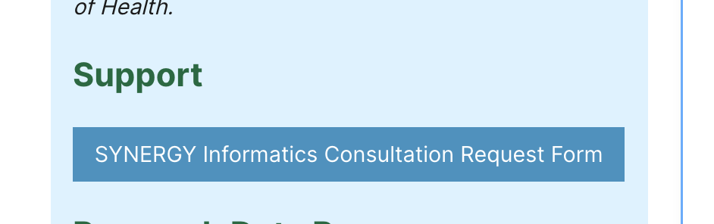
Submitting your study for RIDGe review
STEP 1: Prepare the research study Protocol in the format required for submission for IRB review (HRP-503, found in eIRB in the Library of Templates).
STEP 2: Download and complete the most current version of the Data Request Form, found on the SYNERGY website ‘Data and Informatics’ page
A complete and accurate Data Request Form will minimize iteration between the study team and the ORO Research Informatics team in preparation for the RIDGe review.
STEP 3: Request a SYNERGY Informatics consultation for RIDGe review.
The link will bring up a fillable form where researchers will enter information that provides the Research Informatics team with information about the research team, study, and the specific consult request.
Dartmouth Health ORO - SYNERGY
Research Informatics

Slide 9
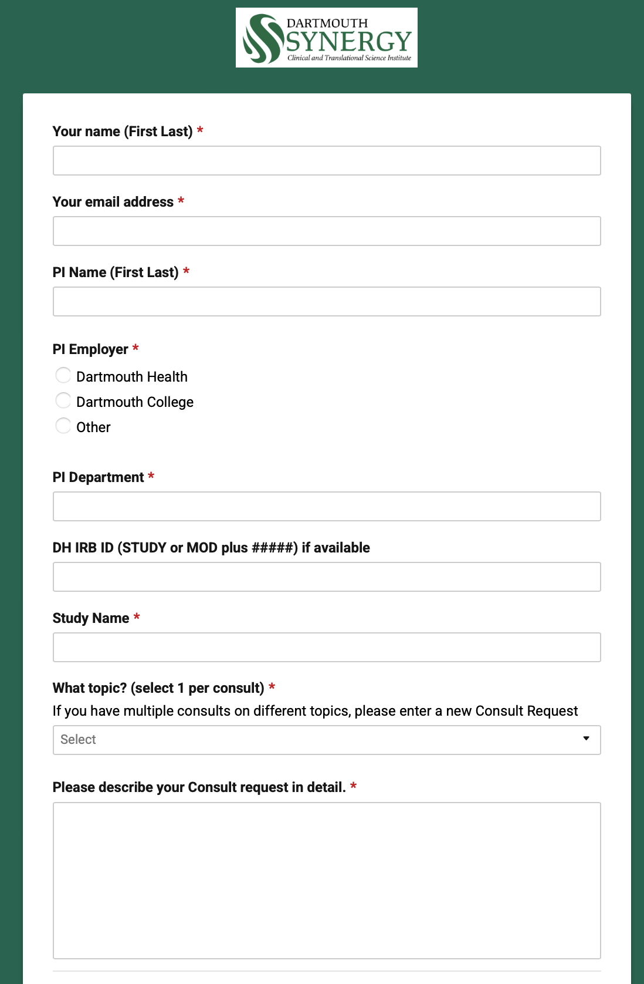
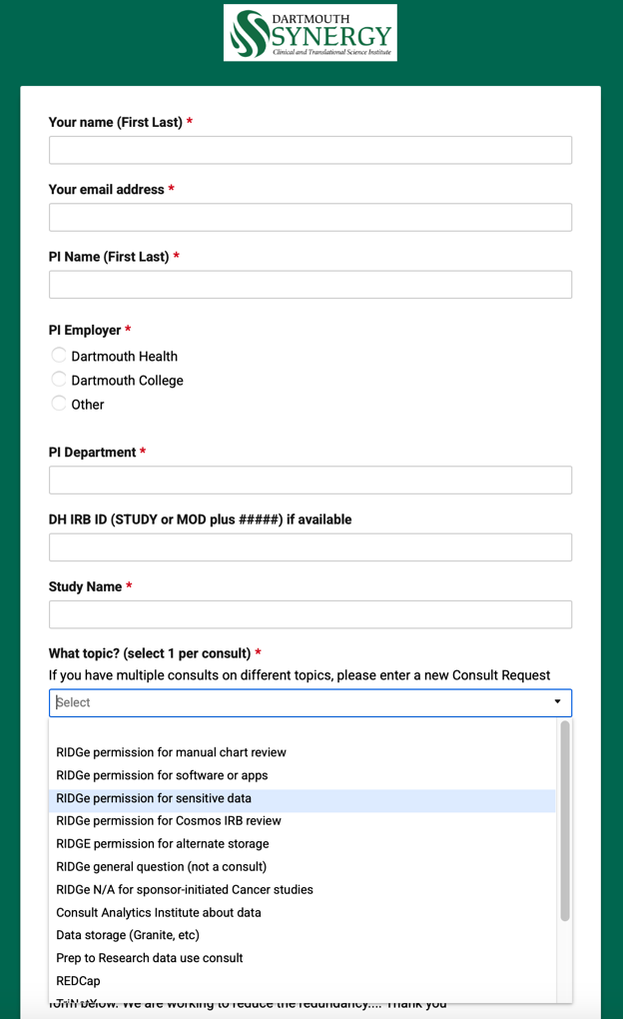
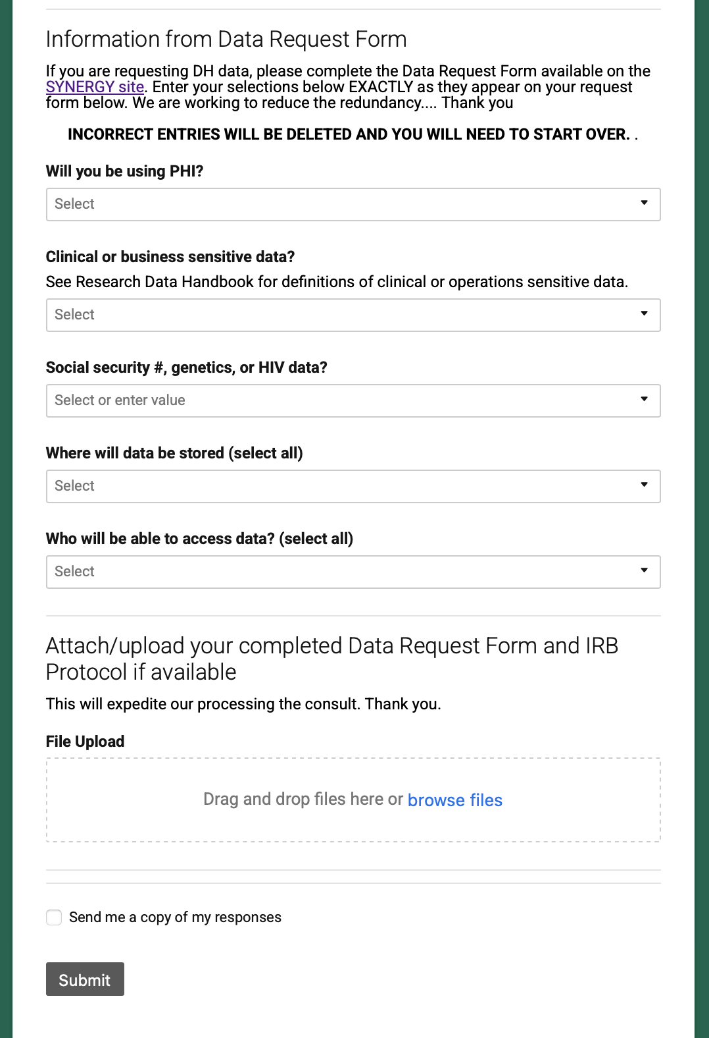
Submitting your study for RIDGe review:
SmartForm
Dartmouth Health ORO - SYNERGY
Research Informatics

Slide 10

What motivates the Data Request Form structure?
The fields in the Data Request Form provide the RIDGe committee with the information needed to effectively and quickly assess the project:
Is the study consented
Is the study funded
What is the classification of the data
What is the classification of the analysis dataset
Is sensitive or business sensitive data being requested
Who is accessing the data
How is the data being stored
Is the data being shared, and with whom
What is the cohort, as defined for the Analytics Institute
What data are you extracting from the medical record …
EXACTLY what data elements need to be part of your data set ….
Do you have a Data Dictionary?
Dartmouth Health ORO - SYNERGY
Research Informatics

Slide 11
Data Engineering starts with questions
Start at the end (analysis) to begin …
What questions address my study endpoints?
What specific data elements are required to answer to those questions?
How can I capture those data elements? Is this data available to me?
Create a data dictionary
Engineer study processes
… end with critical study documentation that can be used to validate systems and processes, and ensure effective analysis. Now you can start!
Dartmouth Health ORO - SYNERGY
Research Informatics

Slide 12
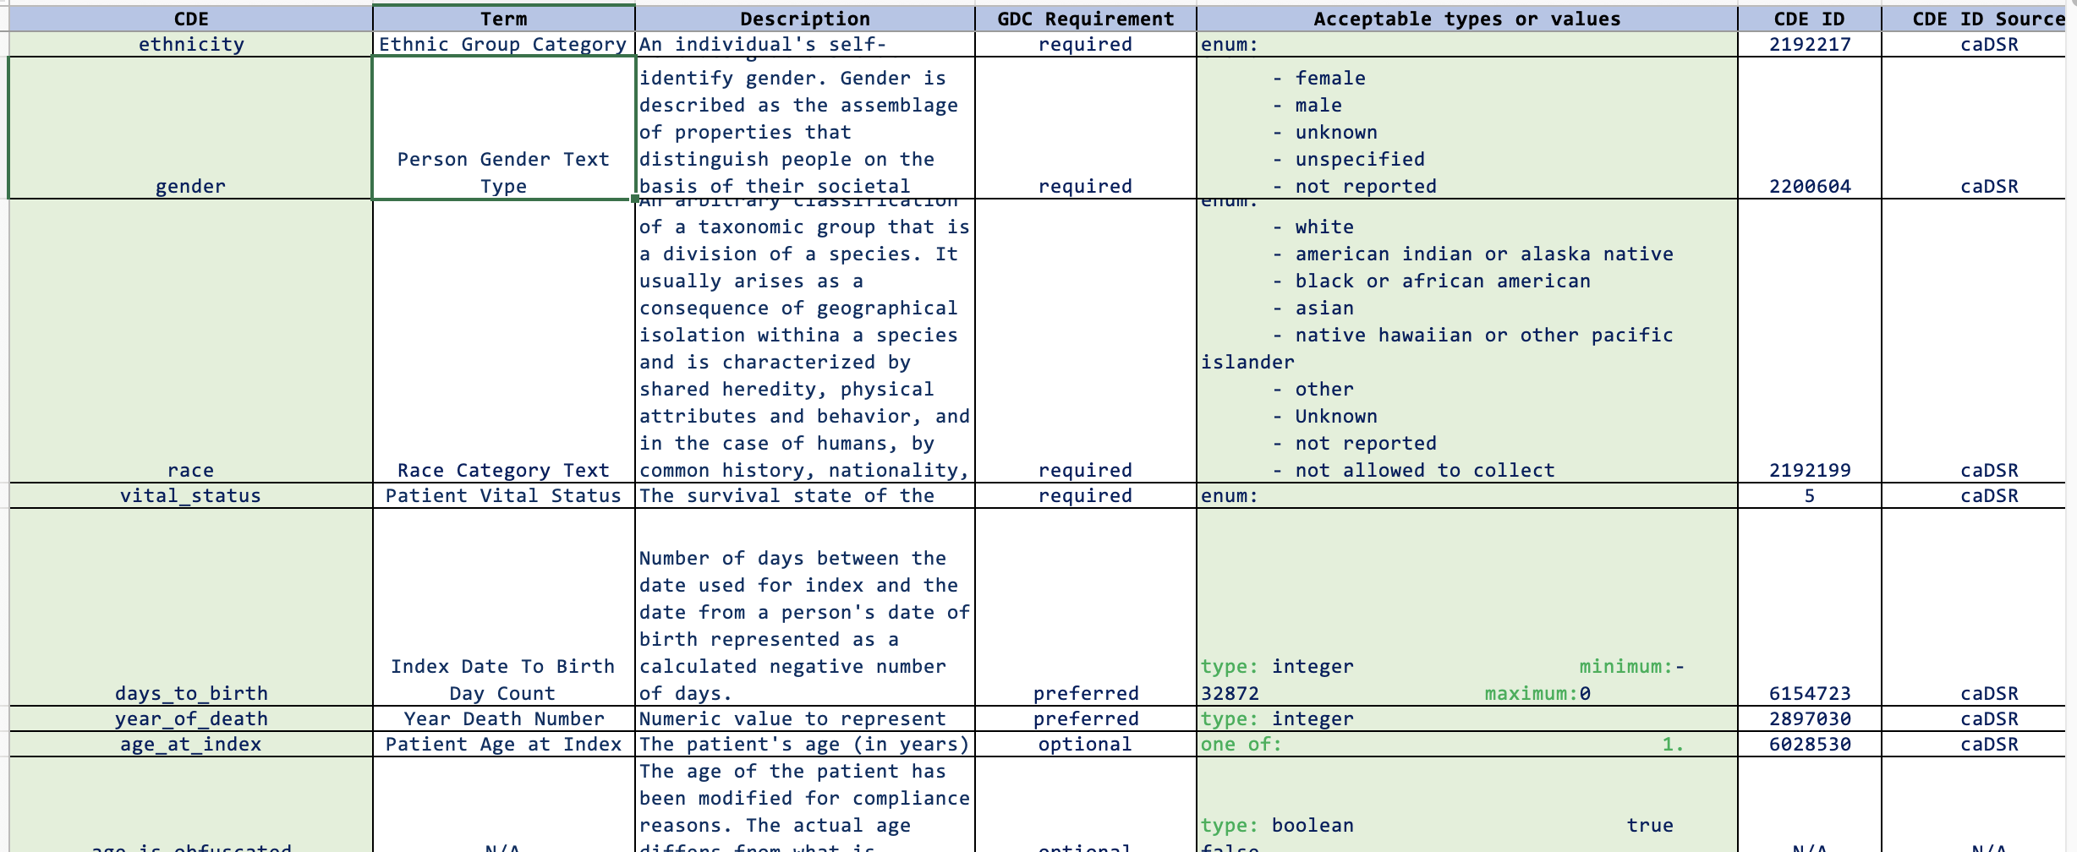
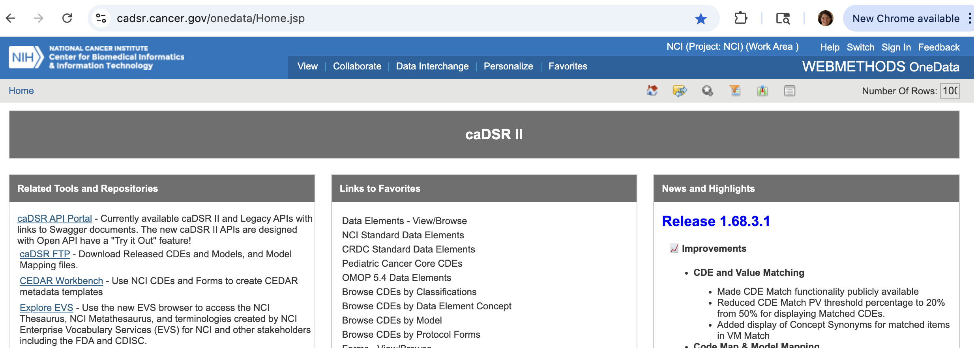
Data Element selection and definition: critical step
Create a Data Dictionary
Data element name, definition, format, standard vocabulary (permissible value list), reference to standard
Consider industry/ national standards for consistency across projects, efficiency in data engineering and software deployment, data defined using ISO (International Organization for Standardization) standards
Facilitates FAIR data (Findable, Accessible, Interoperable, Reusable)
Example: Cancer Data Standards Registry and Repository (caDSR)
Dartmouth Health ORO - SYNERGY
Research Informatics

Slide 13
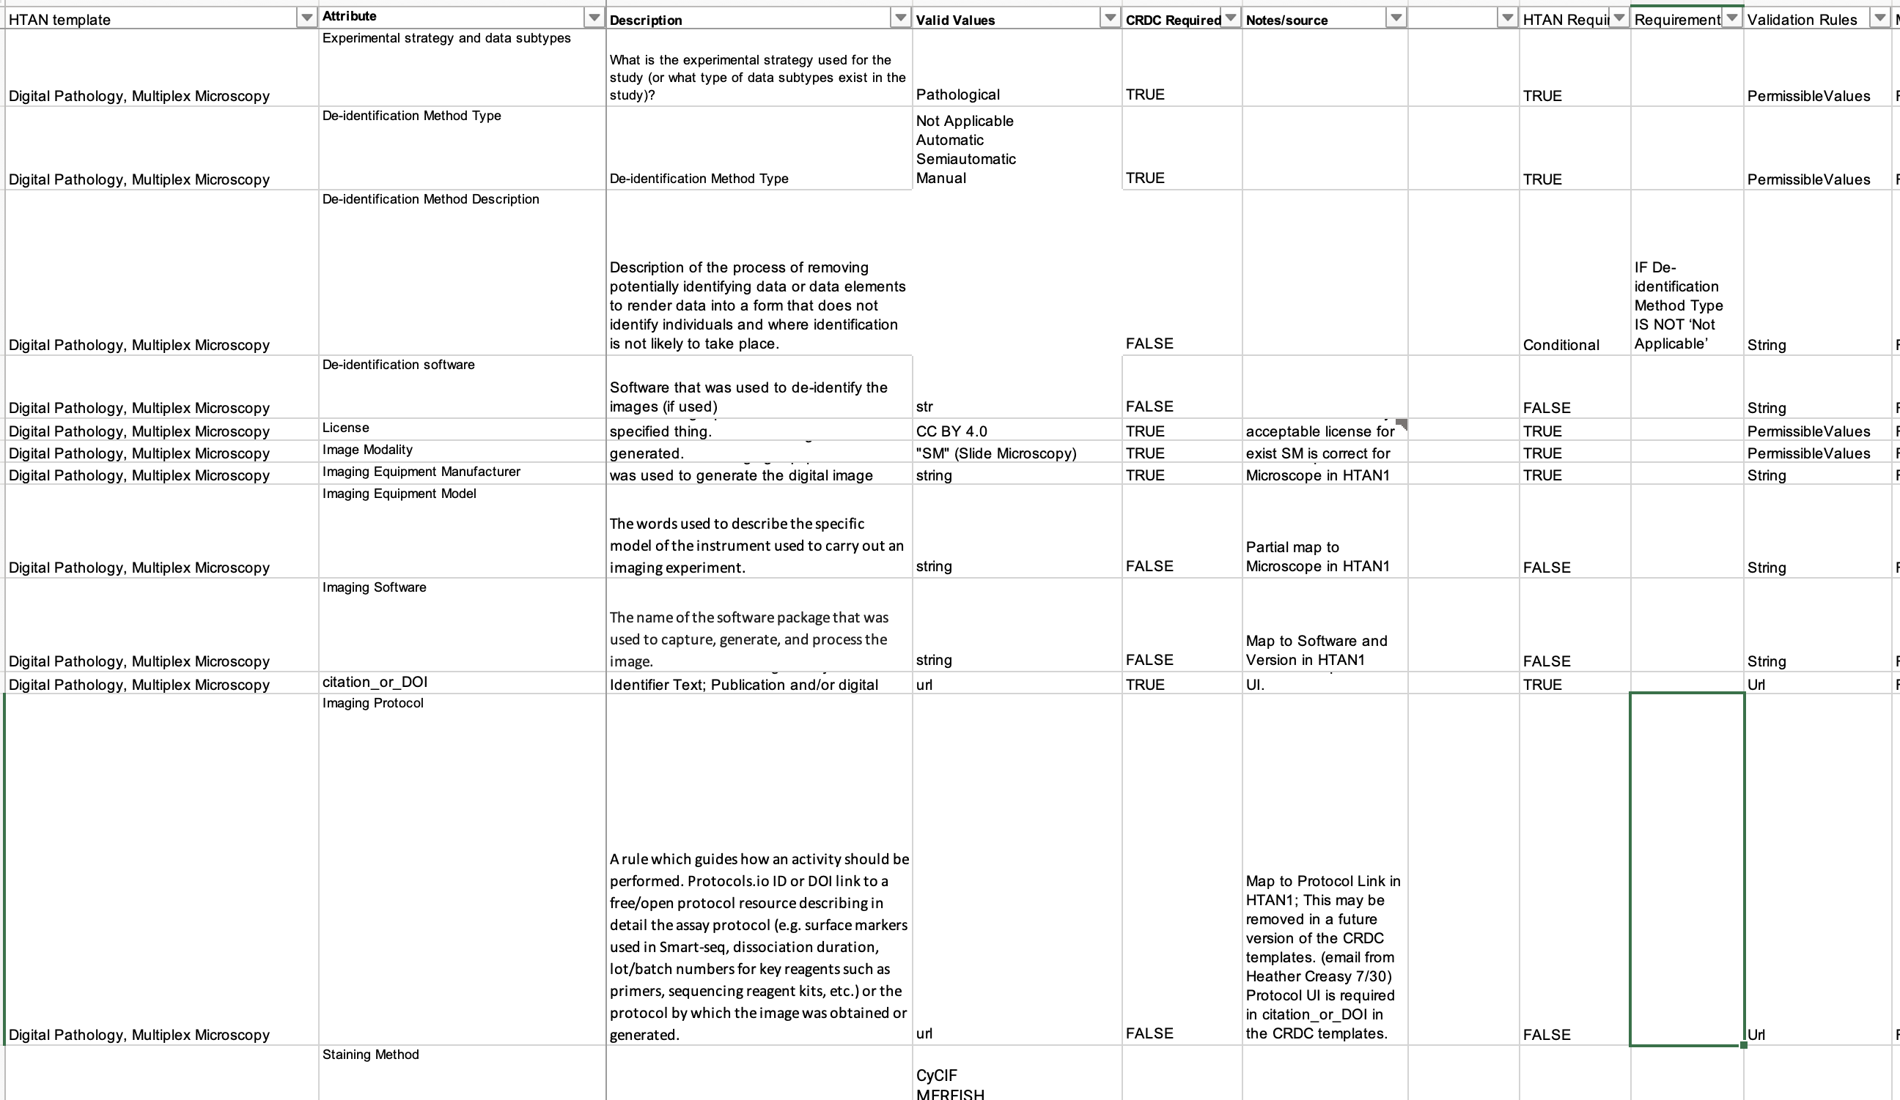
Metadata Standards
Instrument generated biomedical data and biospecimens
Wide variety of available standards (MIAME, DICOM, FHIR, etc.)
Standards evolving with evolving technology
Dartmouth Health ORO - SYNERGY
Research Informatics

Slide 14
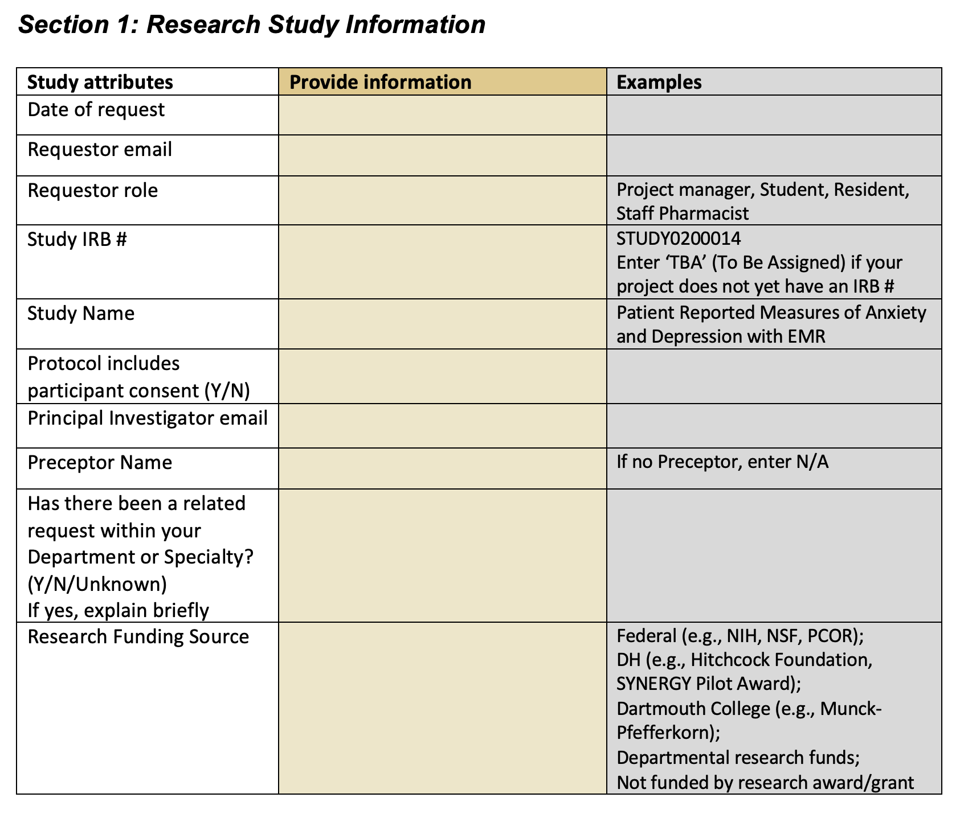
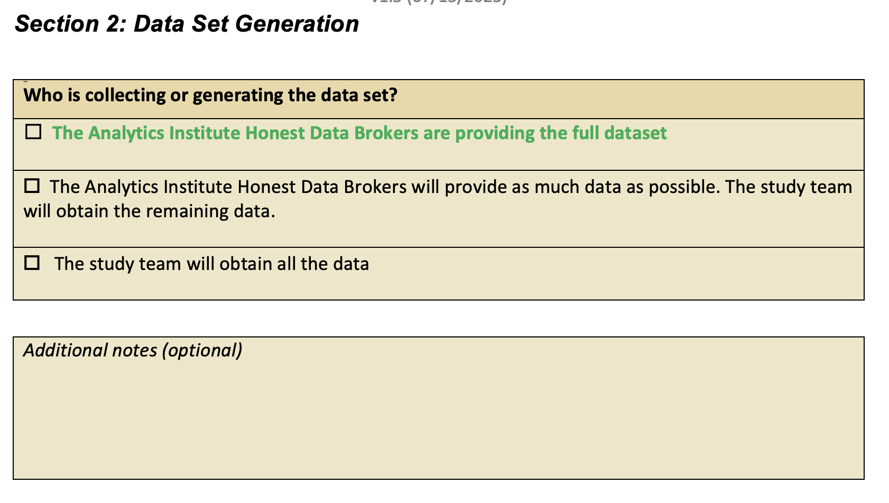
Data Request Form: Structure and Content
Always download the form for your project from synergy.dartmouth.edu to ensure you have the most current version of the Data Request Form.
Options in green text facilitate data access.
Dartmouth Health ORO - SYNERGY
Research Informatics

Slide 15
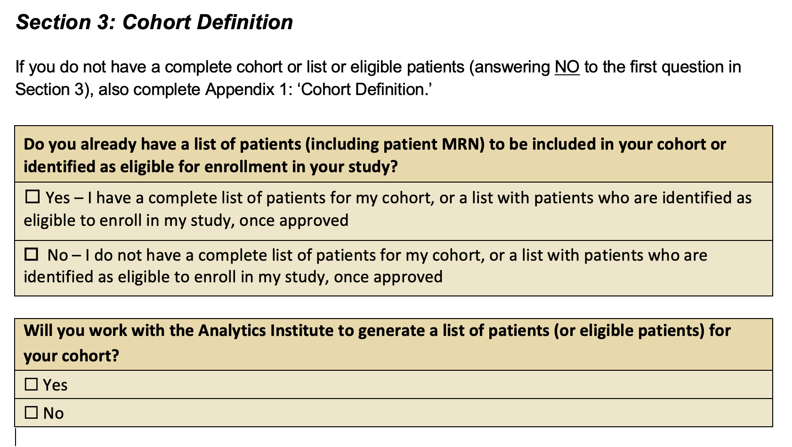
Data Request Form: Cohort
Appendix 1 (last section of the Data Request Form) allows the Analytics Institute Honest Data Brokers to understand your cohort.
Dartmouth Health ORO - SYNERGY
Research Informatics

Slide 16
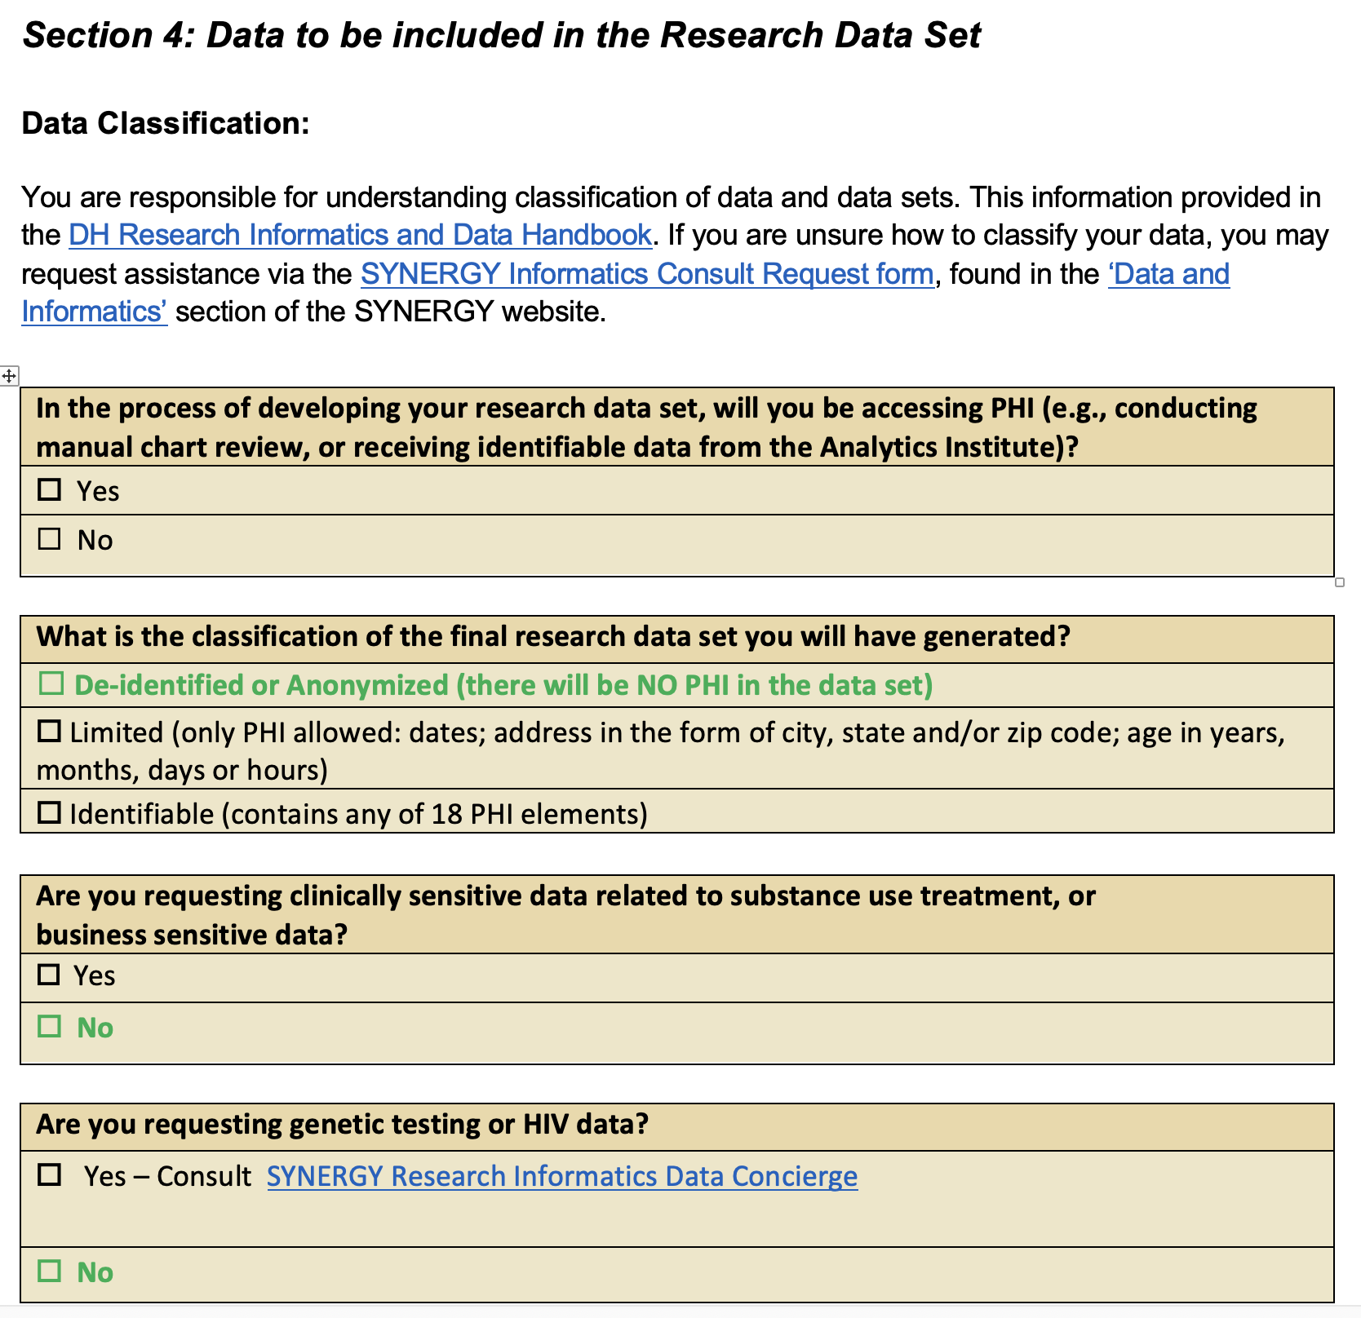
Data Request Form: Data Classification
Policies (in Policy Tech):
10084 Data Classification
7554 Data Disclosure
10675 Data Governance
Dartmouth Health ORO - SYNERGY
Research Informatics

Slide 17
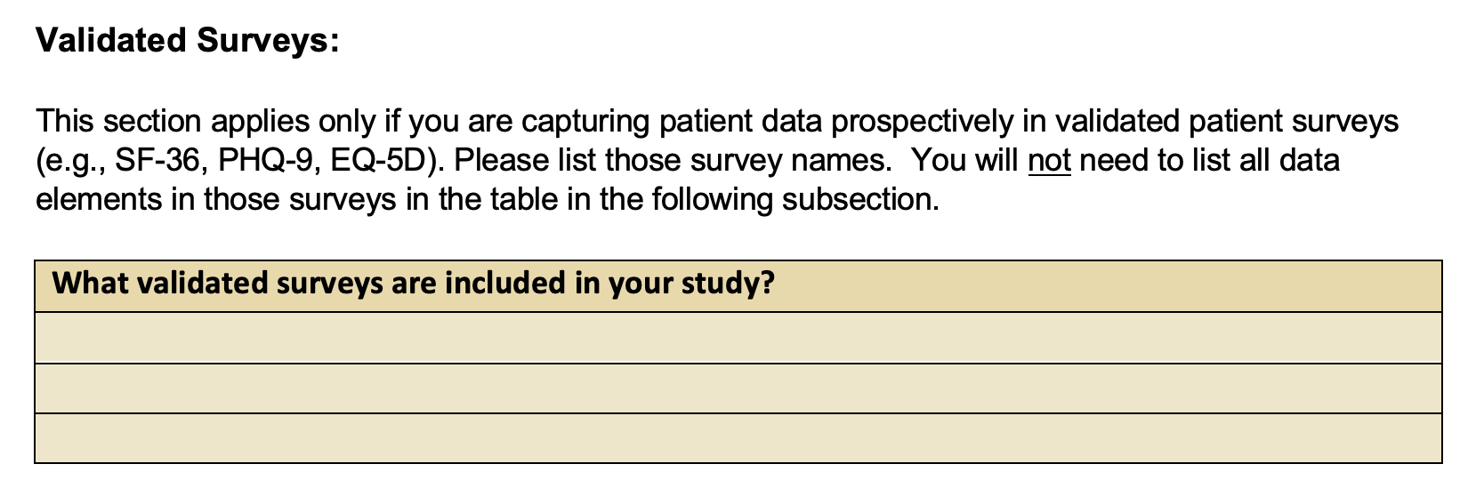
Data Request Form: Validated Instruments
Listing validated surveys allows RIDGe to understand your data elements with your listing out all elements.
Dartmouth Health ORO - SYNERGY
Research Informatics

Slide 18
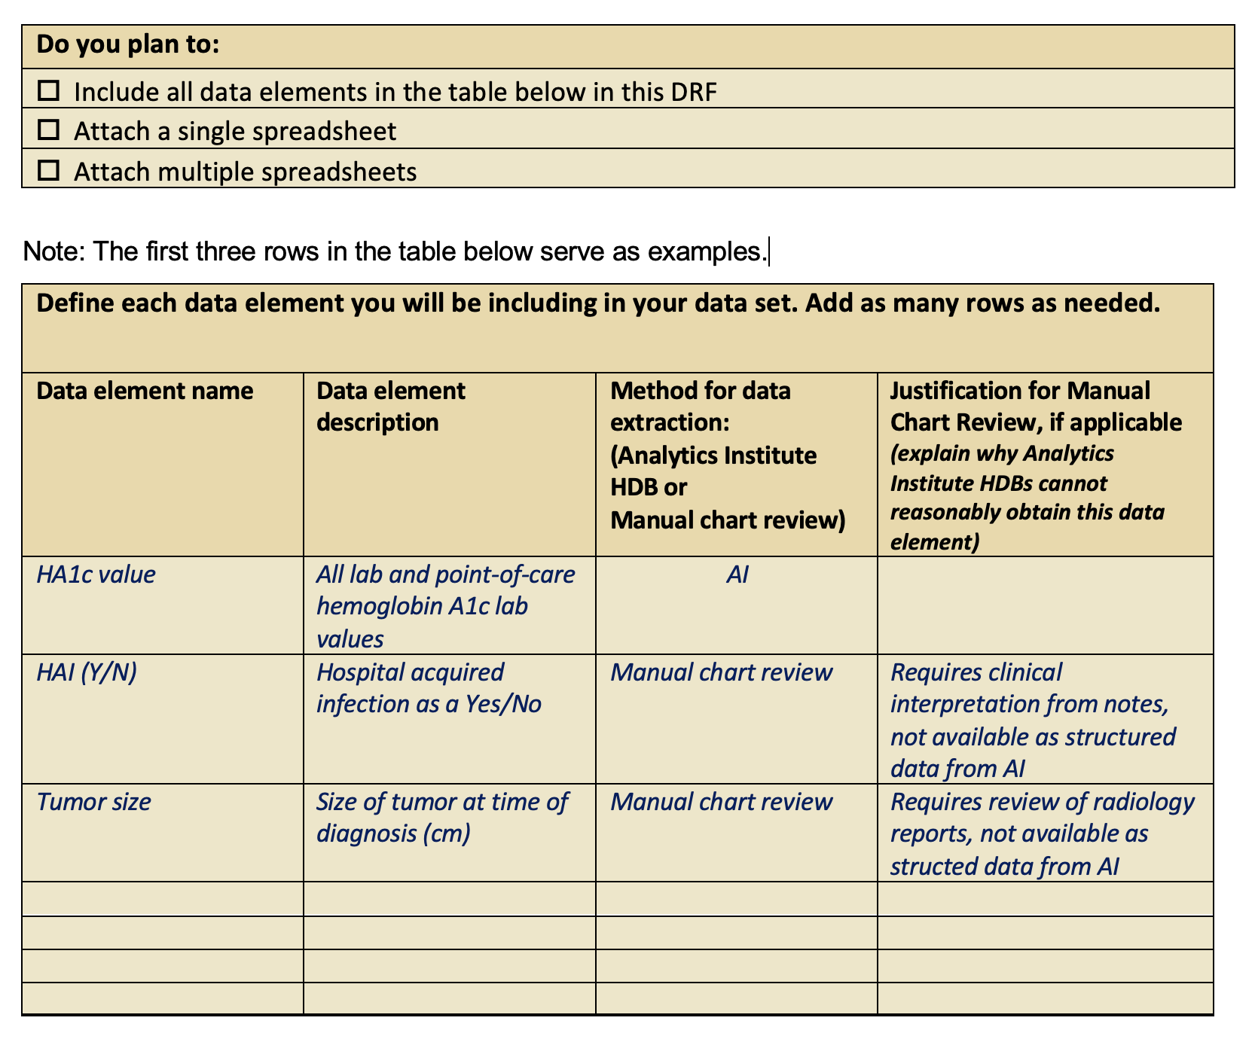
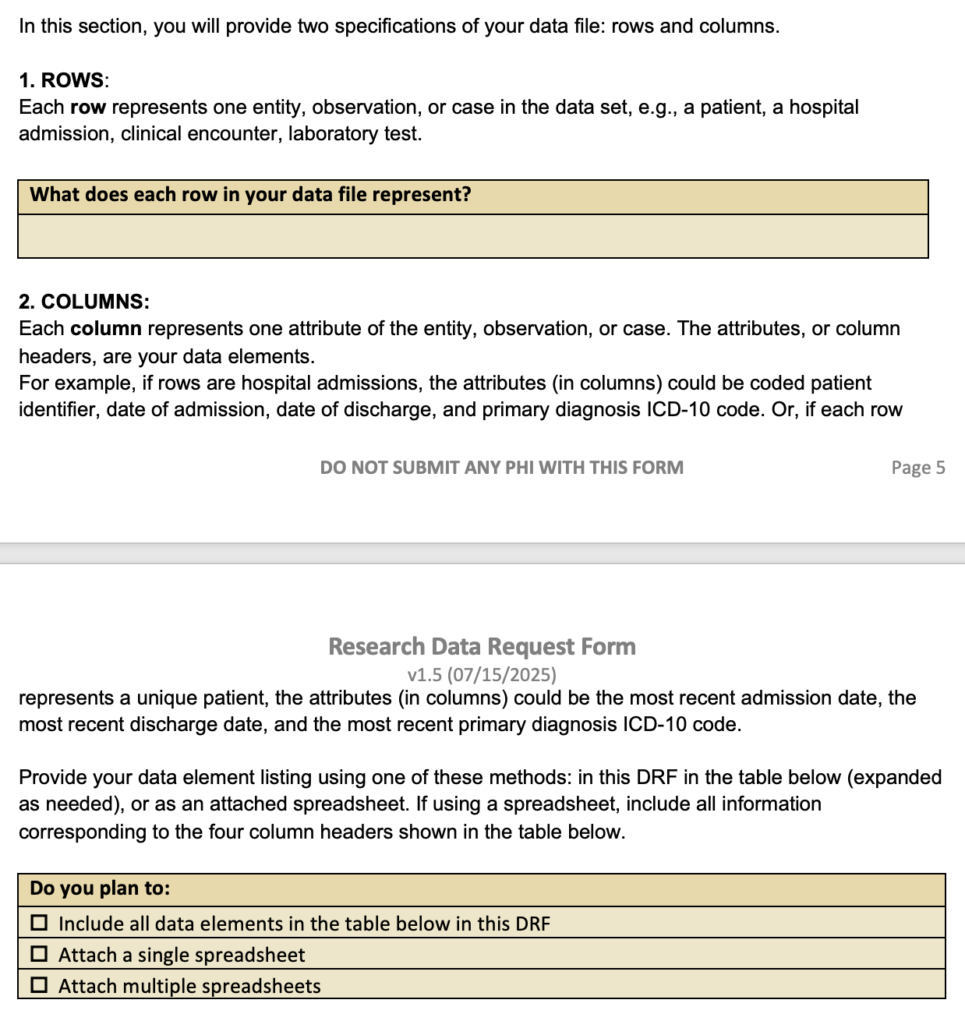
Data Request Form: Data Elements
Include data elements in the Data Request Form, or if easier provide in an alternate file – please include all information.
Dartmouth Health ORO - SYNERGY
Research Informatics

Slide 19
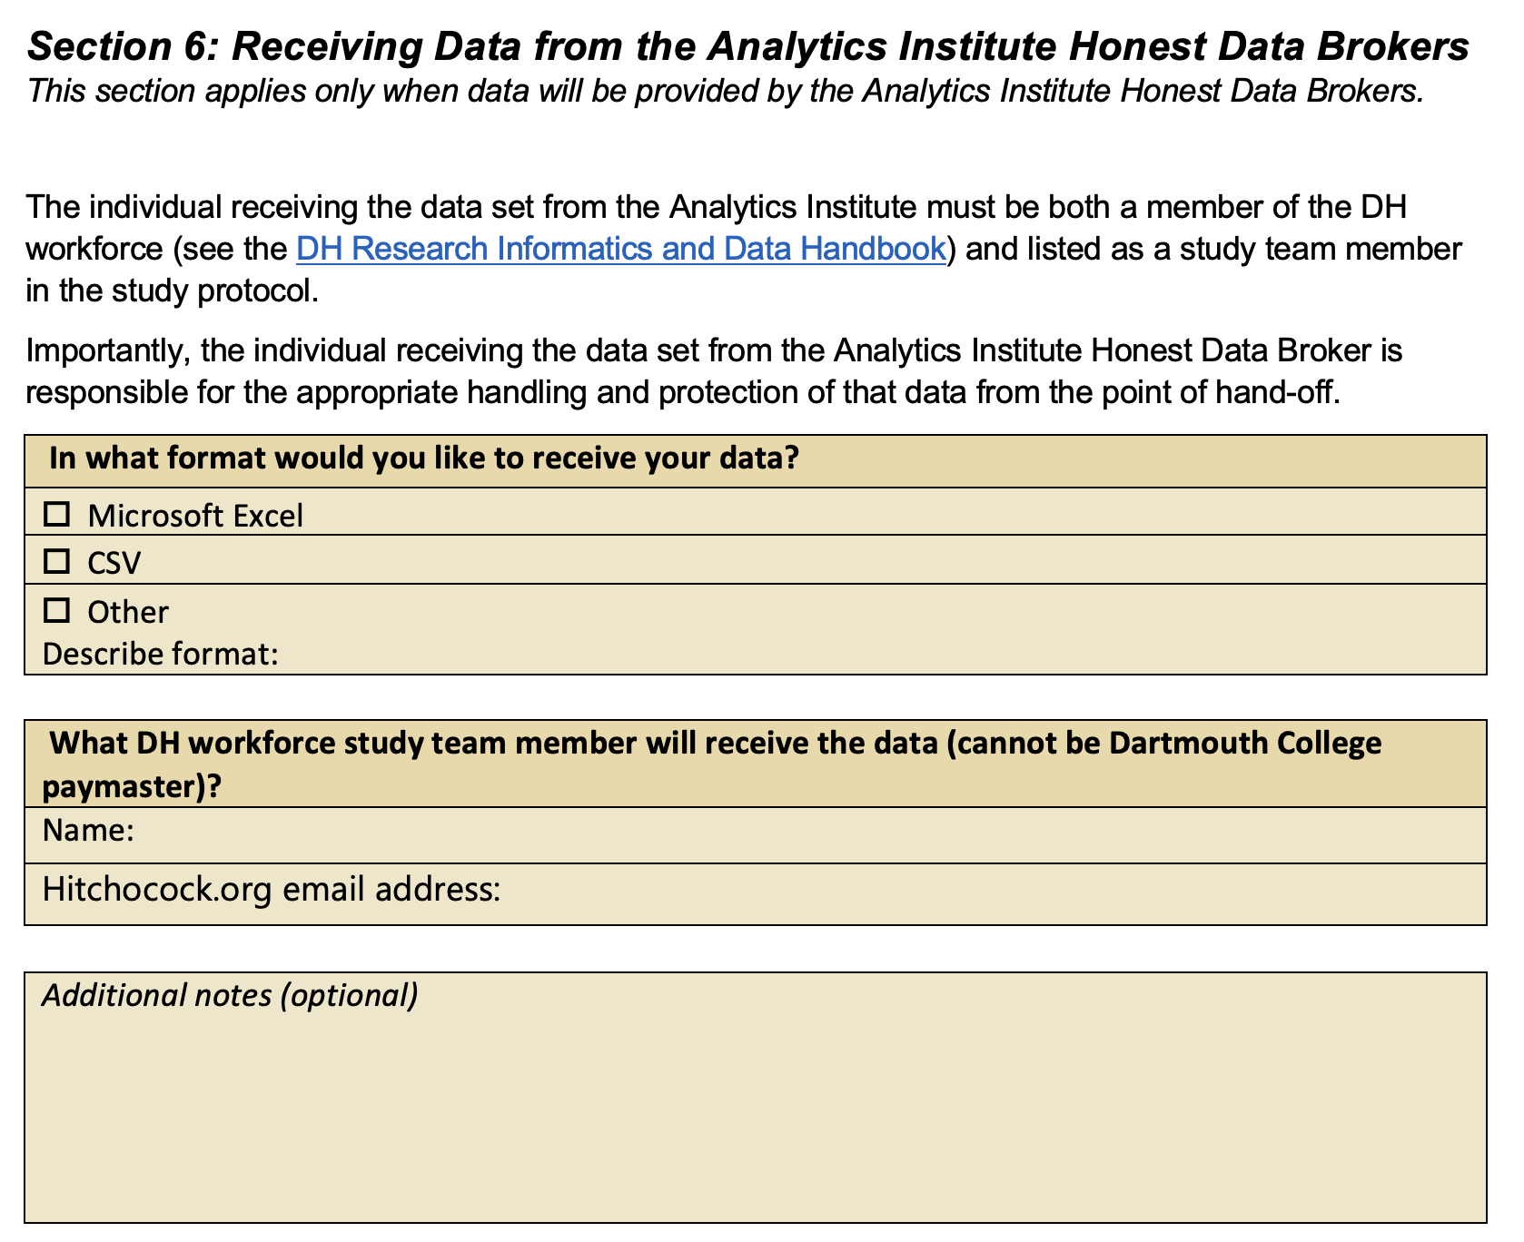
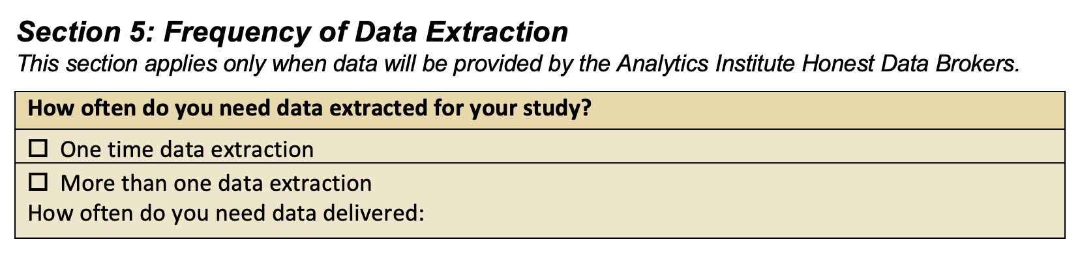
Data Request Form: Analytics Institute
Working with Analytics Institute Honest Data Brokers – Data Request Form provide key information.
Dartmouth Health ORO - SYNERGY
Research Informatics

Slide 20
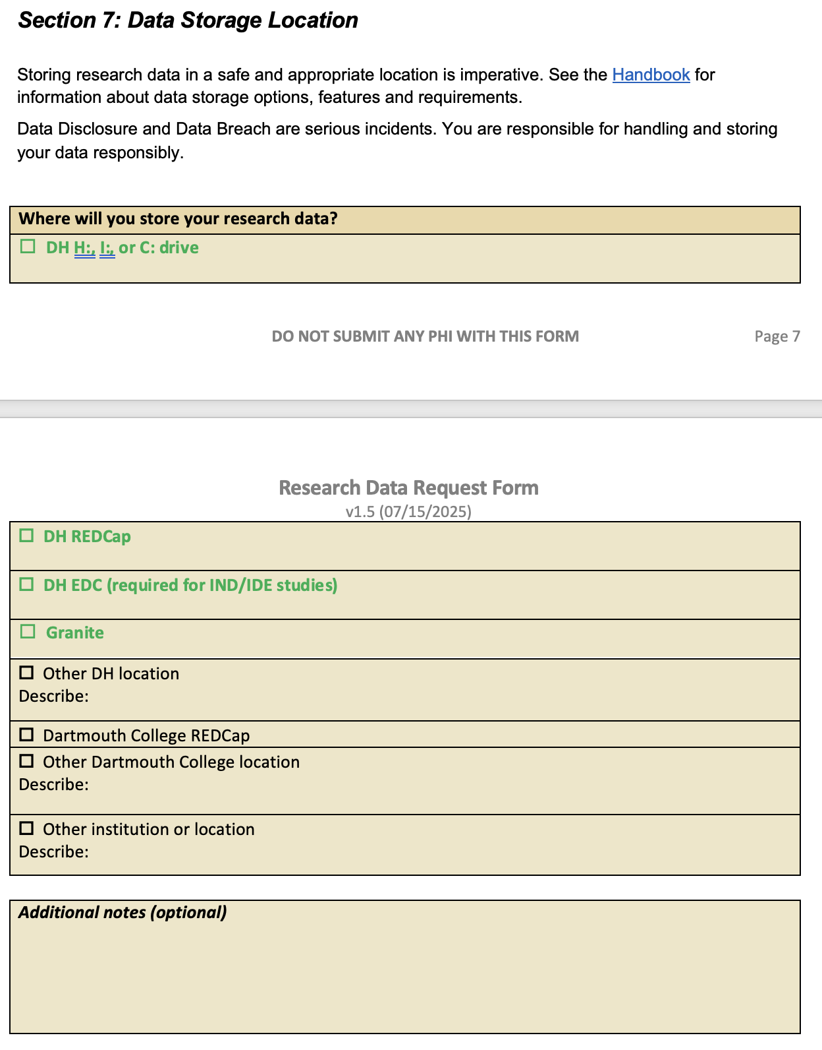
Data Request Form: Data Storage
Dartmouth Health ORO - SYNERGY
Research Informatics

Slide 21
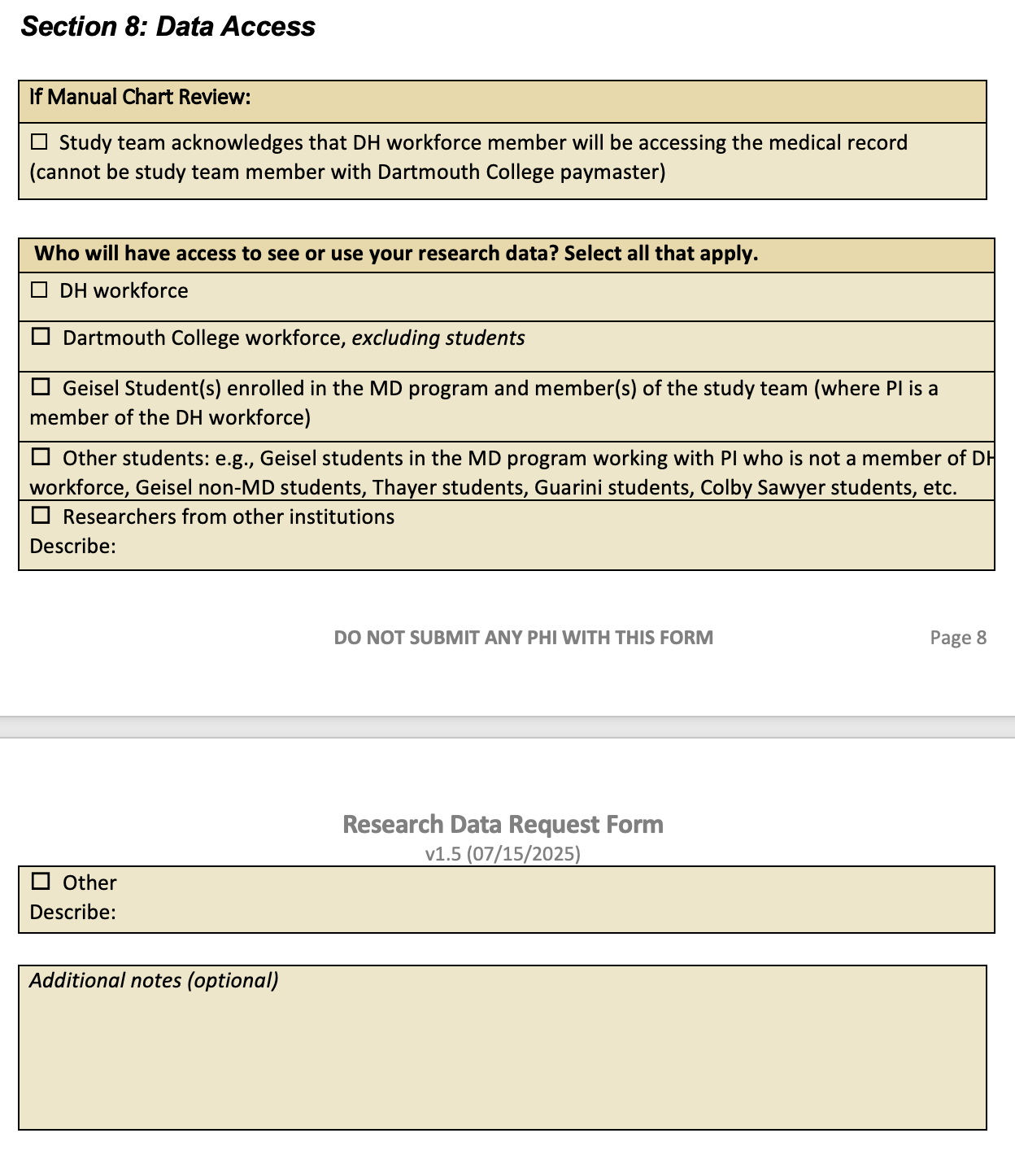
Data Request Form: Data Access
Important for understanding need for DUA or MDUTA:
It is our responsibility to protect our patients’ data wherever it moves for the research
Dartmouth Health ORO - SYNERGY
Research Informatics

Slide 22




RIDGe meeting preparation
Pre-RIDGe preparation aims to ensure that all RIDGe determinations are ‘YES’:
Team reviews each RIDGe review request submission
  Data Request Form, if applicable
  Protocol
  Ancillary documents (e.g., data element spreadsheet)
Background research is often necessary, e.g., are markers somatic or germline
Contact subject matter experts for clarification
Contact study team for clarification
Accept studies for review up to two hours before the RIDGe committee meeting
3 hours per week set aside for collaborative discussion and case preparation …
Timothy Burdick
Charlotte Jeffreys
Kristen Anton
Ruchir Goswami
Dartmouth Health ORO - SYNERGY
Research Informatics

Slide 23
RIDGe meeting preparation
Pre-RIDGe preparation aims to ensure that all RIDGe determinations are ‘YES’:
Team reviews each RIDGe review request submission
  Data Request Form, if applicable
  Protocol
  Ancillary documents (e.g., data element spreadsheet)
Background research is often necessary, e.g., are markers somatic or germline
Contact subject matter experts for clarification
Contact study team for clarification
Accept studies for review up to two hours before the RIDGe committee meeting
Process manager, letter writer, communicator
Timothy Burdick
Charlotte Jeffreys
Ruchir Goswami
Kristen Anton
Dartmouth Health ORO - SYNERGY
Research Informatics

Slide 24

Making RIDGe review go smoothly
Your preparation
  Thorough and accurate description of your request (captured in the Smartform)
  Complete Data Request Form, if applicable
  Complete data element listing, if applicable
Prompt communication – often iterative
  When communication falters for an extended time, case is closed and resubmitting request is required
Please ask questions!
Our goals:
Get your research moving as quickly as possible
Ensure you are aware of all laws and regulations guiding your research project so you can abide them
Be your partner in your research
Dartmouth Health ORO - SYNERGY
Research Informatics

Slide 25
RIDGe determination - notification
Goal is to send approval for all studies – many approvals include guard rails for the activity
RIDGe determination letter is sent via email by EOB Friday of the review week
Letter contains express approval (upload into eIRB)
Letter contains special considerations particular to the study
Letter includes standard language for the activity, if applicable
  Manual Chart Review:
    State of NH prohibits use of HIV testing data and germline genetics in research
    Use of ‘Break the Glass’ encounters for research is prohibited
    Care Everywhere data use is limited by the Epic Rules of the Road
    Use of addiction treatment information from treatment centers is prohibited
Dartmouth Health ORO - SYNERGY
Research Informatics

Slide 26
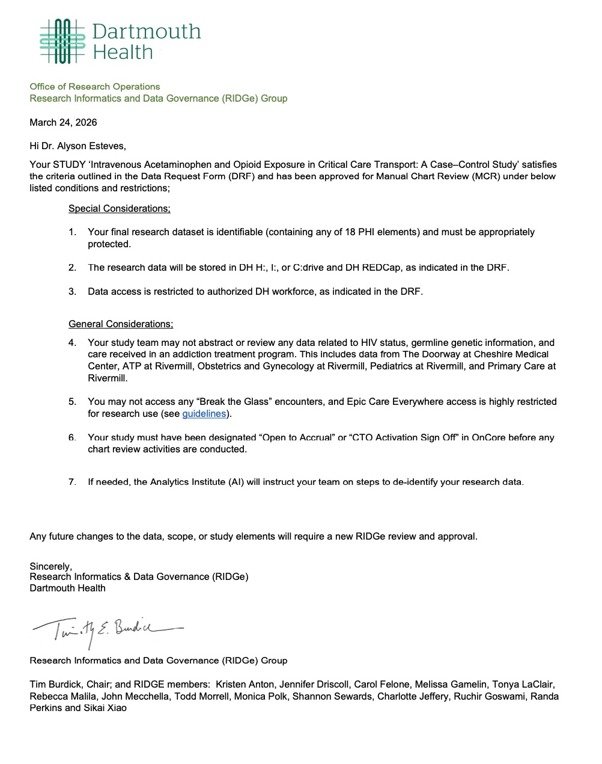
RIDGe determination letter - example
Thank you for feedback about letter structure for ease of reading and use
Dartmouth Health ORO - SYNERGY
Research Informatics

Slide 27
RIDGe determination letter - example
Approval
Project-specific considerations
Conditions apply to all access to the medical record for research
Changes may require review
Dartmouth Health ORO - SYNERGY
Research Informatics

Slide 28
Use Cases
Retrospective Manual Chart Review:
“Evaluation of short- and long-term complications in children with G-tube”
STUDY02003392 (row ID 939) Reto Baertschiger
3rd Party Software
“Human-Artificial Intelligence (HAI) Interaction Patterns in Radiology Image Interpretation with Eye Tracking”
STUDY02003277 (row ID 899) Jessica Sin
Consented study
Alternative Storage
”A Pilot Study on the Technical Feasibility Bioimpedance-based Intraoperative Lung Nodule Detection”
STUDY02003267 (row ID 916) Kathy Phipps
Dartmouth Health ORO - SYNERGY
Research Informatics

Slide 29
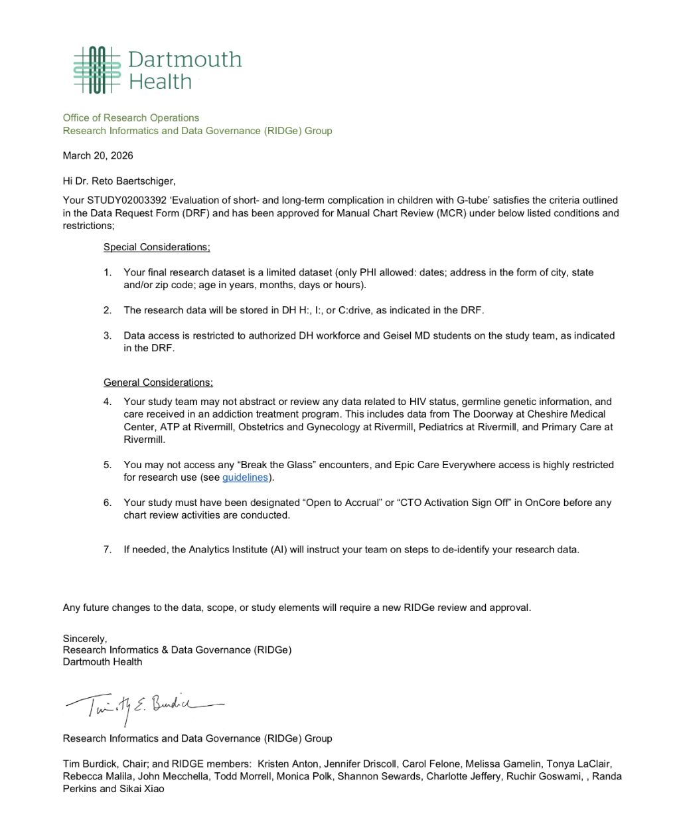
Use Cases
Retrospective Manual Chart Review:
“Evaluation of short- and long-term complications in children with G-tube”
STUDY02003392 (row ID 939) Reto Baertschiger
Dartmouth Health ORO - SYNERGY
Research Informatics

Slide 30
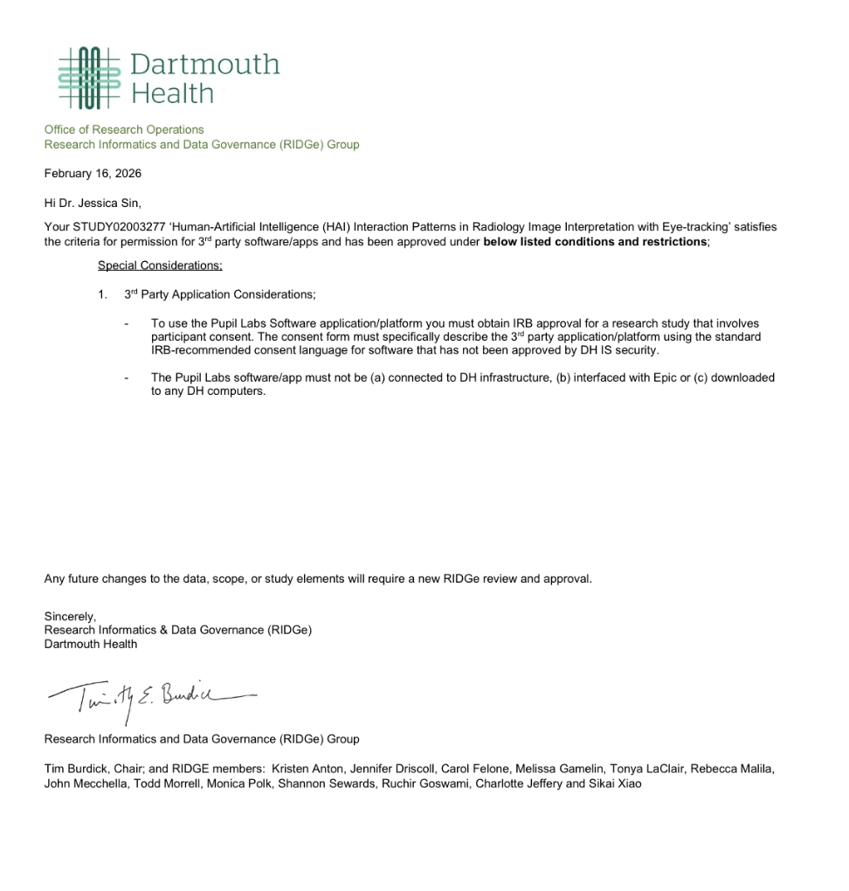
Use Cases
3rd Party Software
“Human-Artificial Intelligence (HAI) Interaction Patterns in Radiology Image Interpretation with Eye Tracking”
STUDY02003277 (row ID 899) Jessica Sin
Consented study
Dartmouth Health ORO - SYNERGY
Research Informatics

Slide 31
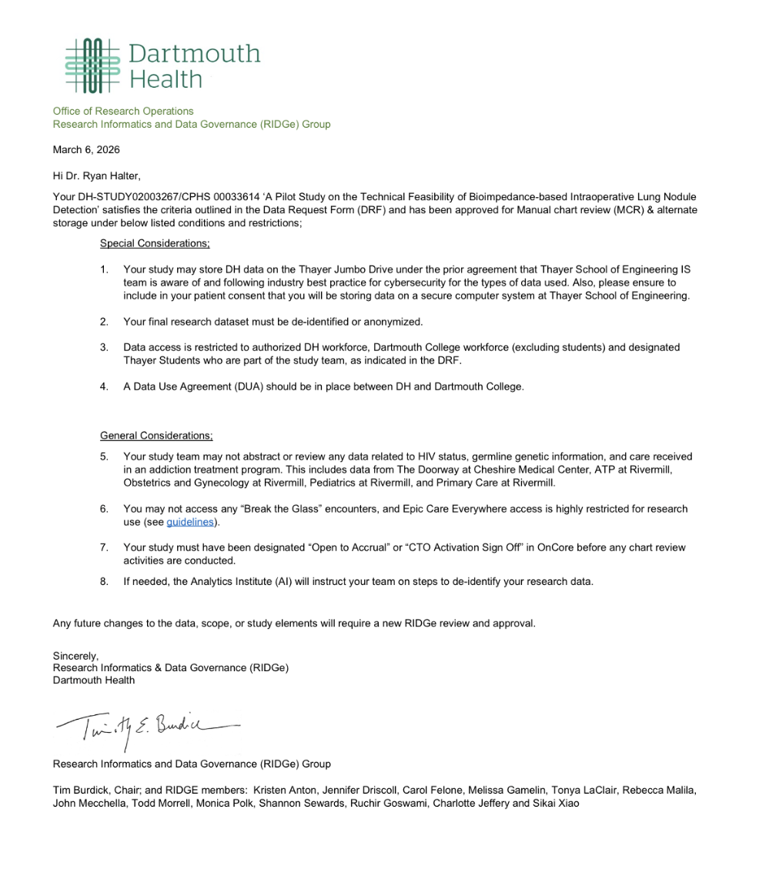
Use Cases
Alternative Storage
”A Pilot Study on the Technical Feasibility Bioimpedance-based Intraoperative Lung Nodule Detection”
STUDY02003267 (row ID 916) Ryan Halter
Dartmouth Health ORO - SYNERGY
Research Informatics

