Slide 1


Dartmouth SYNERGY Translational Pilot Award Program INFO Session
Pilot program directors:
JoAnna Leyenaar, MD PhD
Jennifer Bomberger, PhD

Slide 2
Dartmouth SYNERGY Translational Pilot Award Program
Pilot program funds innovative, multidisciplinary research proposals that have clear potential for translation into patient-oriented care, with priority for improving population health for rural communities.
The pilot program’s goal is to facilitate collaborative translational science across Dartmouth institutions and affiliated health centers, ranging from proof-of-concept studies to delivery system-based interventions to interrogations of large population databases that have relevance to rural health.

Slide 3
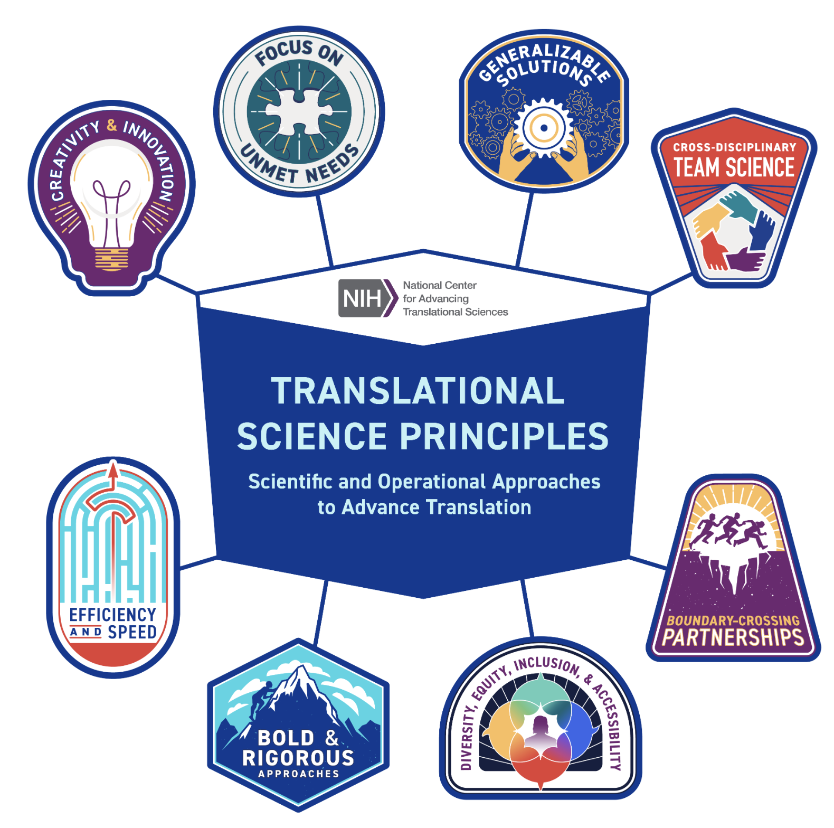
What is translational science?
https://ncats.nih.gov/about/about-translational-science/principles
“Translational science is the field that generates innovations that overcome longstanding challenges along the translational research pipeline. These include scientific, operational, financial and administrative innovations that transform the way that research is done, making it faster, more efficient, and more impactful.”

Slide 4
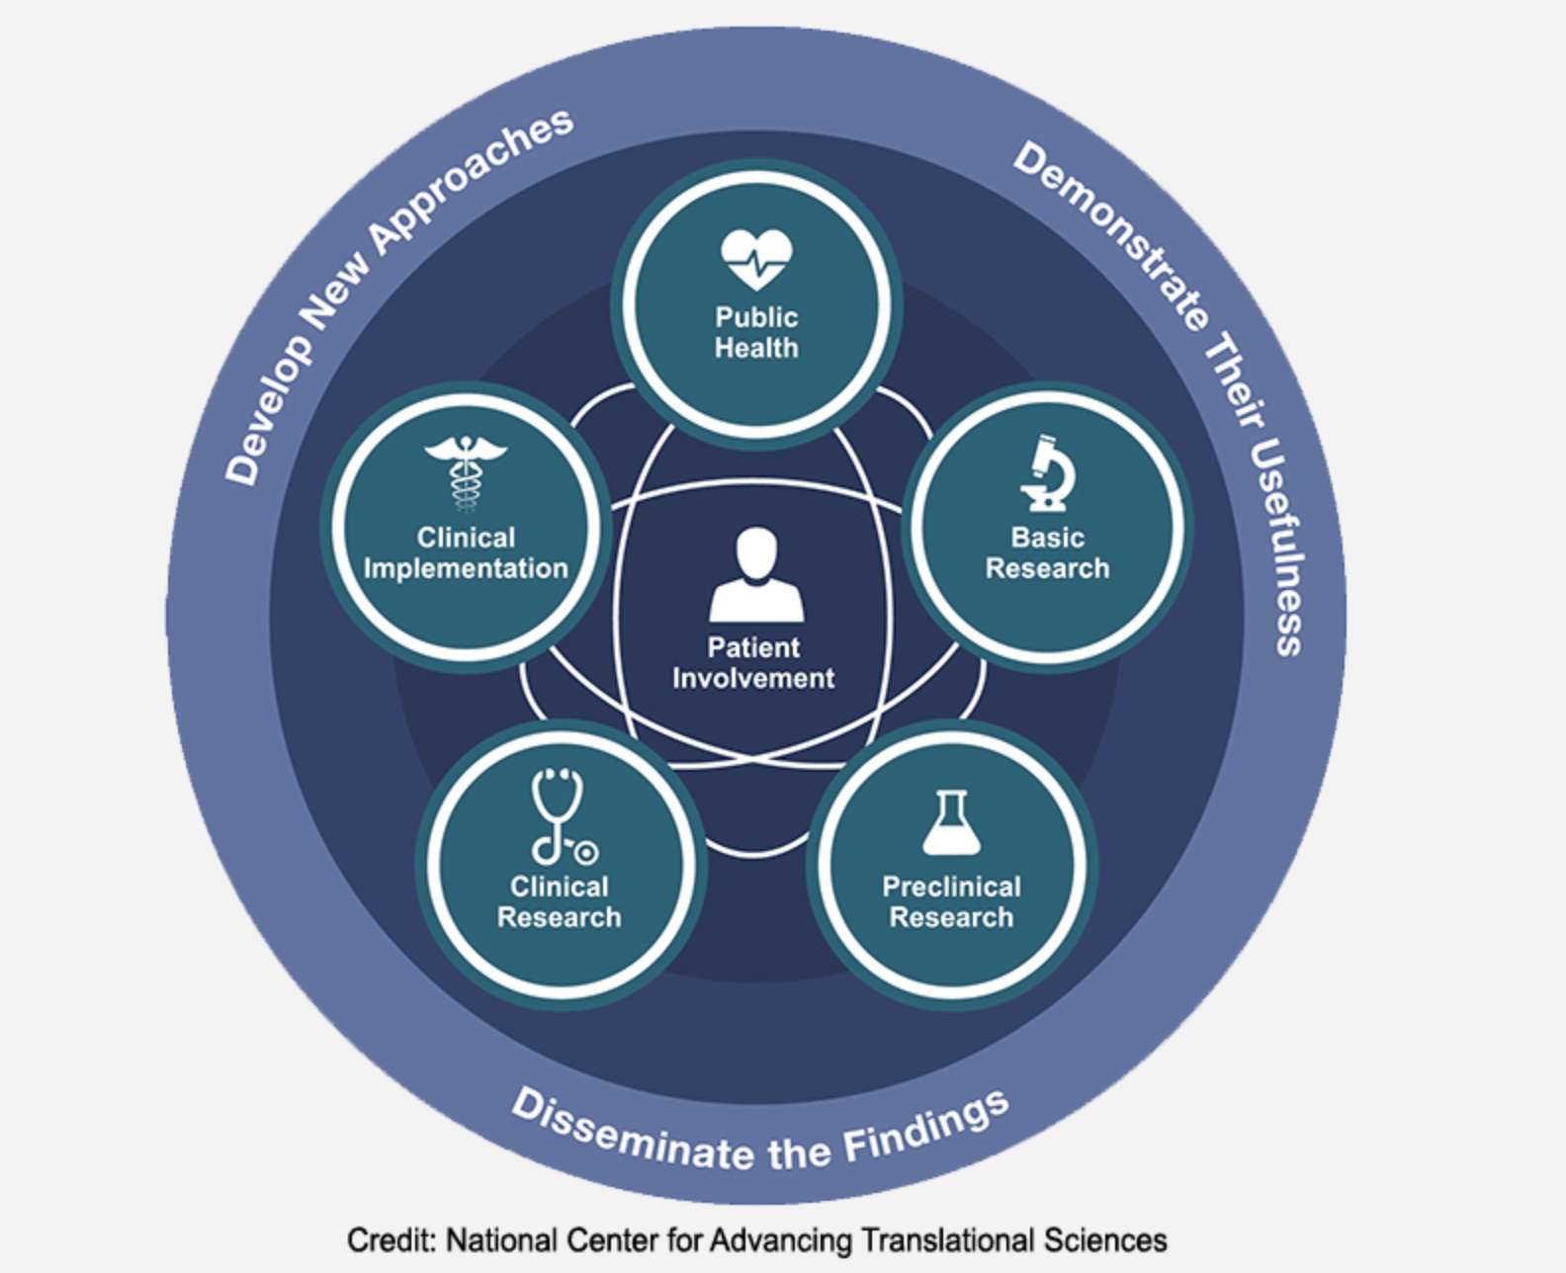
What are the types of translational research?
“The translational science spectrum shows the stages of translational research. The stages do not happen in a straight line or in one direction. Each stage builds upon and informs the others. At all stages, our staff and grantees come up with new approaches, prove their usefulness and share the findings. Patient involvement is a key feature of all stages in translation.”
https://ncats.nih.gov/about/about-translational-science/spectrum

Slide 5

How do I know if my project is relevant to rural health?
https://ncats.nih.gov/research/research-activities/ctsa/projects/rural-health

Slide 6
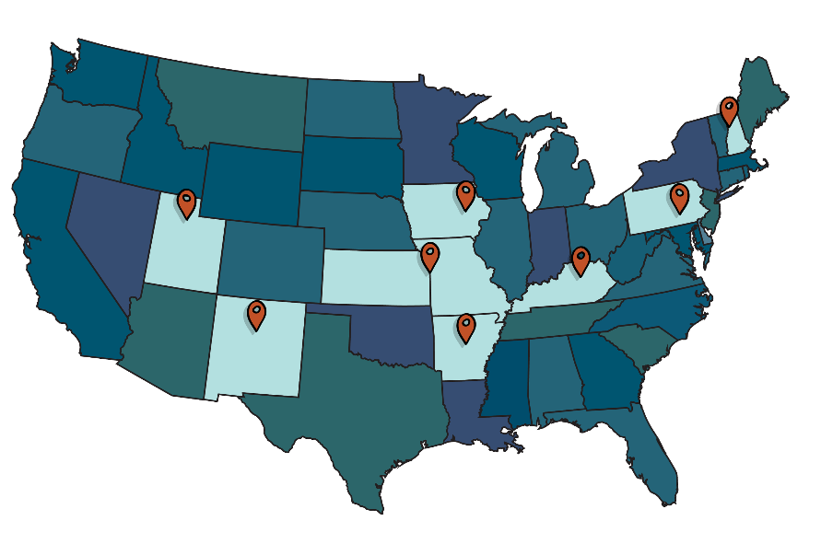

Consortium of Rural States (CORES) Multi-Institutional Pilot Award Program
Provides one-year funding for early- and mid-career researchers to support impactful, innovative, and collaborative clinical and translational research.
Aims:
1. Accelerate the research progress of emerging investigators by providing them with resources to gather crucial preliminary data for future applications, leading to trials of new treatments, interventions, devices, or novel diagnostic or analytical methods.
2. Encourage research addressing clinical issues significant to rural populations in the SYNERGY at Dartmouth catchment area. These projects should also have broader applications to general healthcare.
Notes:
Rural communities, which constitute 20% of the U.S. population, experience severe health disparities compared to their urban counterparts. According to the CDC, an array of demographic, environmental, economic, and social factors put rural residents at higher risk of death and poor health outcomes than people who live in urban areas.
The Consortium of Rural States (CORES) is a collaborative research consortium of eight academic medical institutions that are working to improve health in rural communities and are funded by the Clinical & Translational Science Award (CTSA) from the National Center for Advancing Translational Sciences (NCATS) at the National Institutes of Health.
Through inter-institutional pilot funding and sharing best practices, CORES aims to accelerate research efforts that can reduce the burden of illness and mortality in rural populations.

Slide 7
2027 Request for SYNERGY Pilot applications

Slide 8
Eligibility
Investigators with an academic appointment at Dartmouth (including Geisel, Thayer, Tuck, A&S, Dartmouth Health, the VA, and affiliated sites) who meet the requirements below are eligible to apply.
To foster multidisciplinary and multi-center research, the application must list a Contact Principal Investigator (PI) and multiple Principal Investigators (MPIs), each from a different discipline, department, or school.
The contact PI must have a Dartmouth faculty appointment at the rank of instructor, research scientist, assistant professor, or associate professor.
Should the contact PI and MPI be at a junior faculty member rank of instructor, research scientist, or assistant professor, the applicants must identify their research mentor(s) in the Letter of Intent (LOI).
Investigators are limited to a single application as the contact PI in a given application cycle.

Slide 9
Budget
Proposed research timeline beginning on July 1, 2027 and ending June 30, 2028
The pilot project must be completed within 12 months with a direct cost budget of $20,000 to $50,000
Award amounts will vary depending on the scope of the proposed work, its scientific merit, feasibility, and relevance to SYNERGY’s mission
Salary support for investigators is permissible and is limited to the NIH salary cap plus fringe
Budgets include direct costs only
Acceptable budgetary items must adhere to NIH guidelines

Slide 10
Successful applications
Pilot Awards will be given priority if the research is at an early stage and needs support to create preliminary data and/or to develop research concepts that will advance translational science.
Successful proposals must have a high chance of leading to extramurally funded research and/or discoveries with the potential for commercialization.
Thoughtfully discuss utility of pilot award in research program development in LOI.
Impactful application of proposed research to rural communities and/or rural health.

Slide 11
Process
Competitive Letter of Intent to select full applications to invite.
Full applications invited to provide more detailed description of proposed studies, as well as opportunity to respond to reviewer feedback from LOI stage.
Application review by pilot directors and SYNERGY PIs to identify applications to put forward to NCATS approval.
Funding of applications with regulatory and NCATS approval.

Slide 12
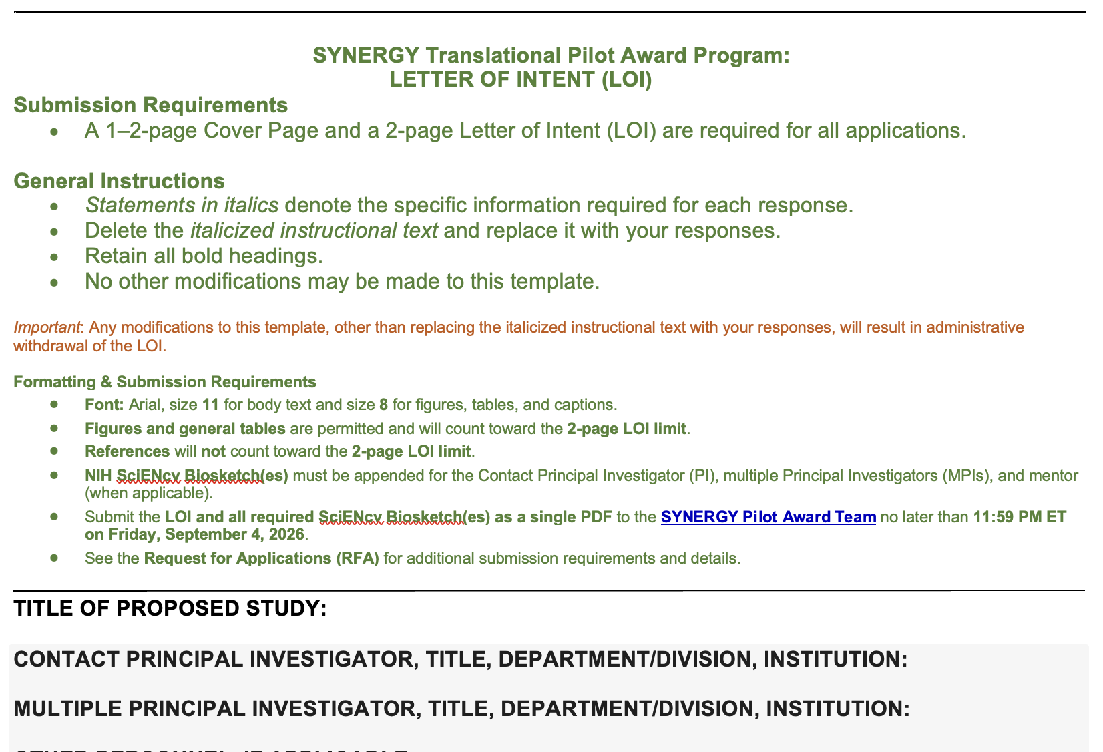
What needs to be included in the Letter of Intent?
The Letter of Intent (LOI) template must be used for submissions. This is a competitive LOI and will be reviewed by a multidisciplinary review committee to select proposals to move on to the full application stage.

Slide 13
What needs to be included in the Letter of Intent?
Tips for Competitive LOI stage
Deadlines are firm, there will be no extensions permitted
Please follow the format on the LOI form and complete all sections
NIH SciENcv biosketches are required. See here for examples and assistance in creating this biosketch and be sure to schedule time for this step!
  https://www.ncbi.nlm.nih.gov/sciencv/
Start early and ask a colleague to review your application before submission. Remember to write your application to be compelling to a multi-disciplinary review panel
Clearly articulate impact of research on translational science
The Letter of Intent (LOI) template must be used for submissions. This is a competitive LOI and will be reviewed by a multidisciplinary review committee to select proposals to move on to the full application stage.
Notes:
SciENcv

Slide 14
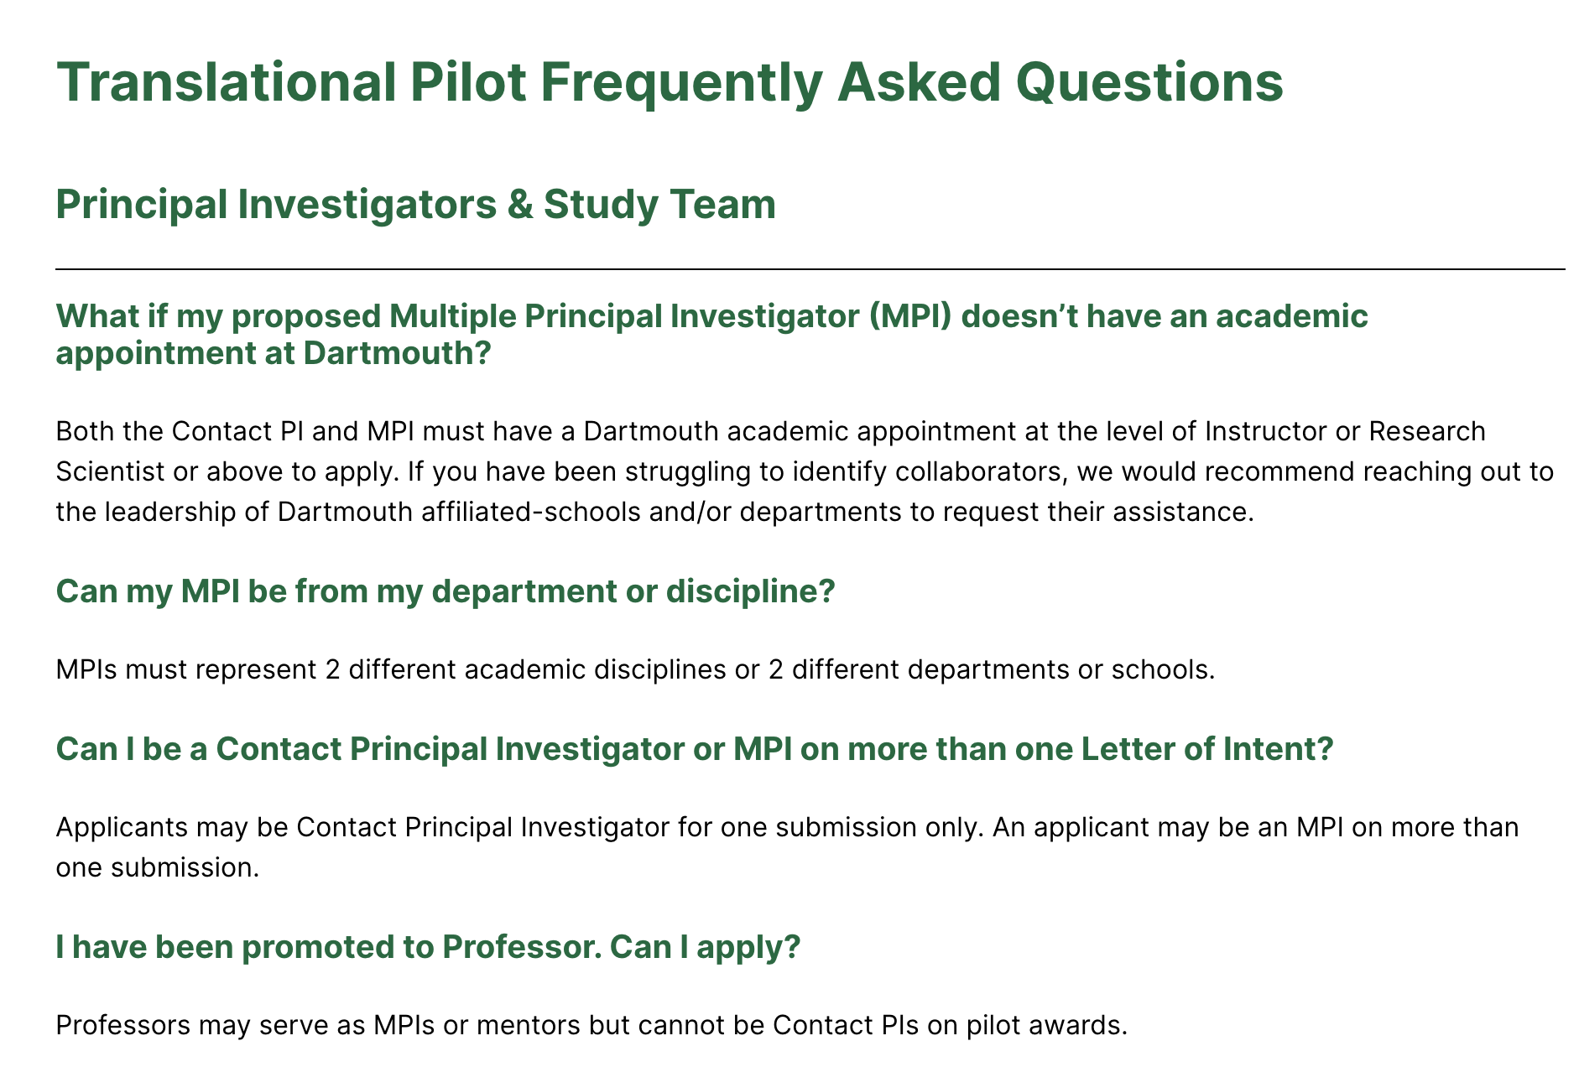
Answers to other FAQs are provided on the SYNERGY Website
https://synergy.dartmouth.edu/translational-pilot-grants/

Slide 15
2027 SYNERGY Pilot Program Key Dates
RFA Release Date: June 30, 2026
Informational Meeting: July 23, 2026
Office Hours (unstructured opportunity for Q&A): August 12, 2026, 12pm (Zoom link will be posted on Synergy website)
Letter of Intent Due Date: September 4, 2026
Invitation for Full Applications: October 16, 2026
Full Applicate Due Date: December 11, 2026
Funding Start Date: July 1, 2027

